Slide 1
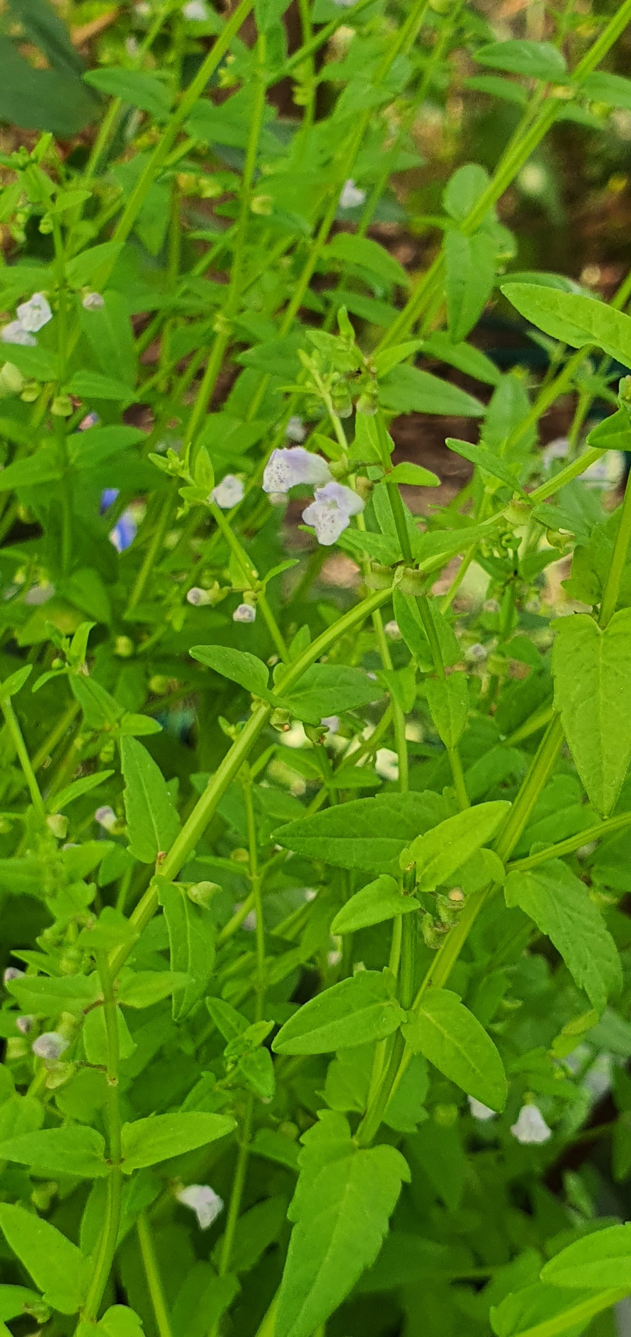


An analysis of phytochemical diversity in Scutellaria to identify species with medicinal potential
Bryce Askey
Horticultural Sciences Department, University of Florida, Gainesville, FL, USA
Scutellaria dependens

Slide 2
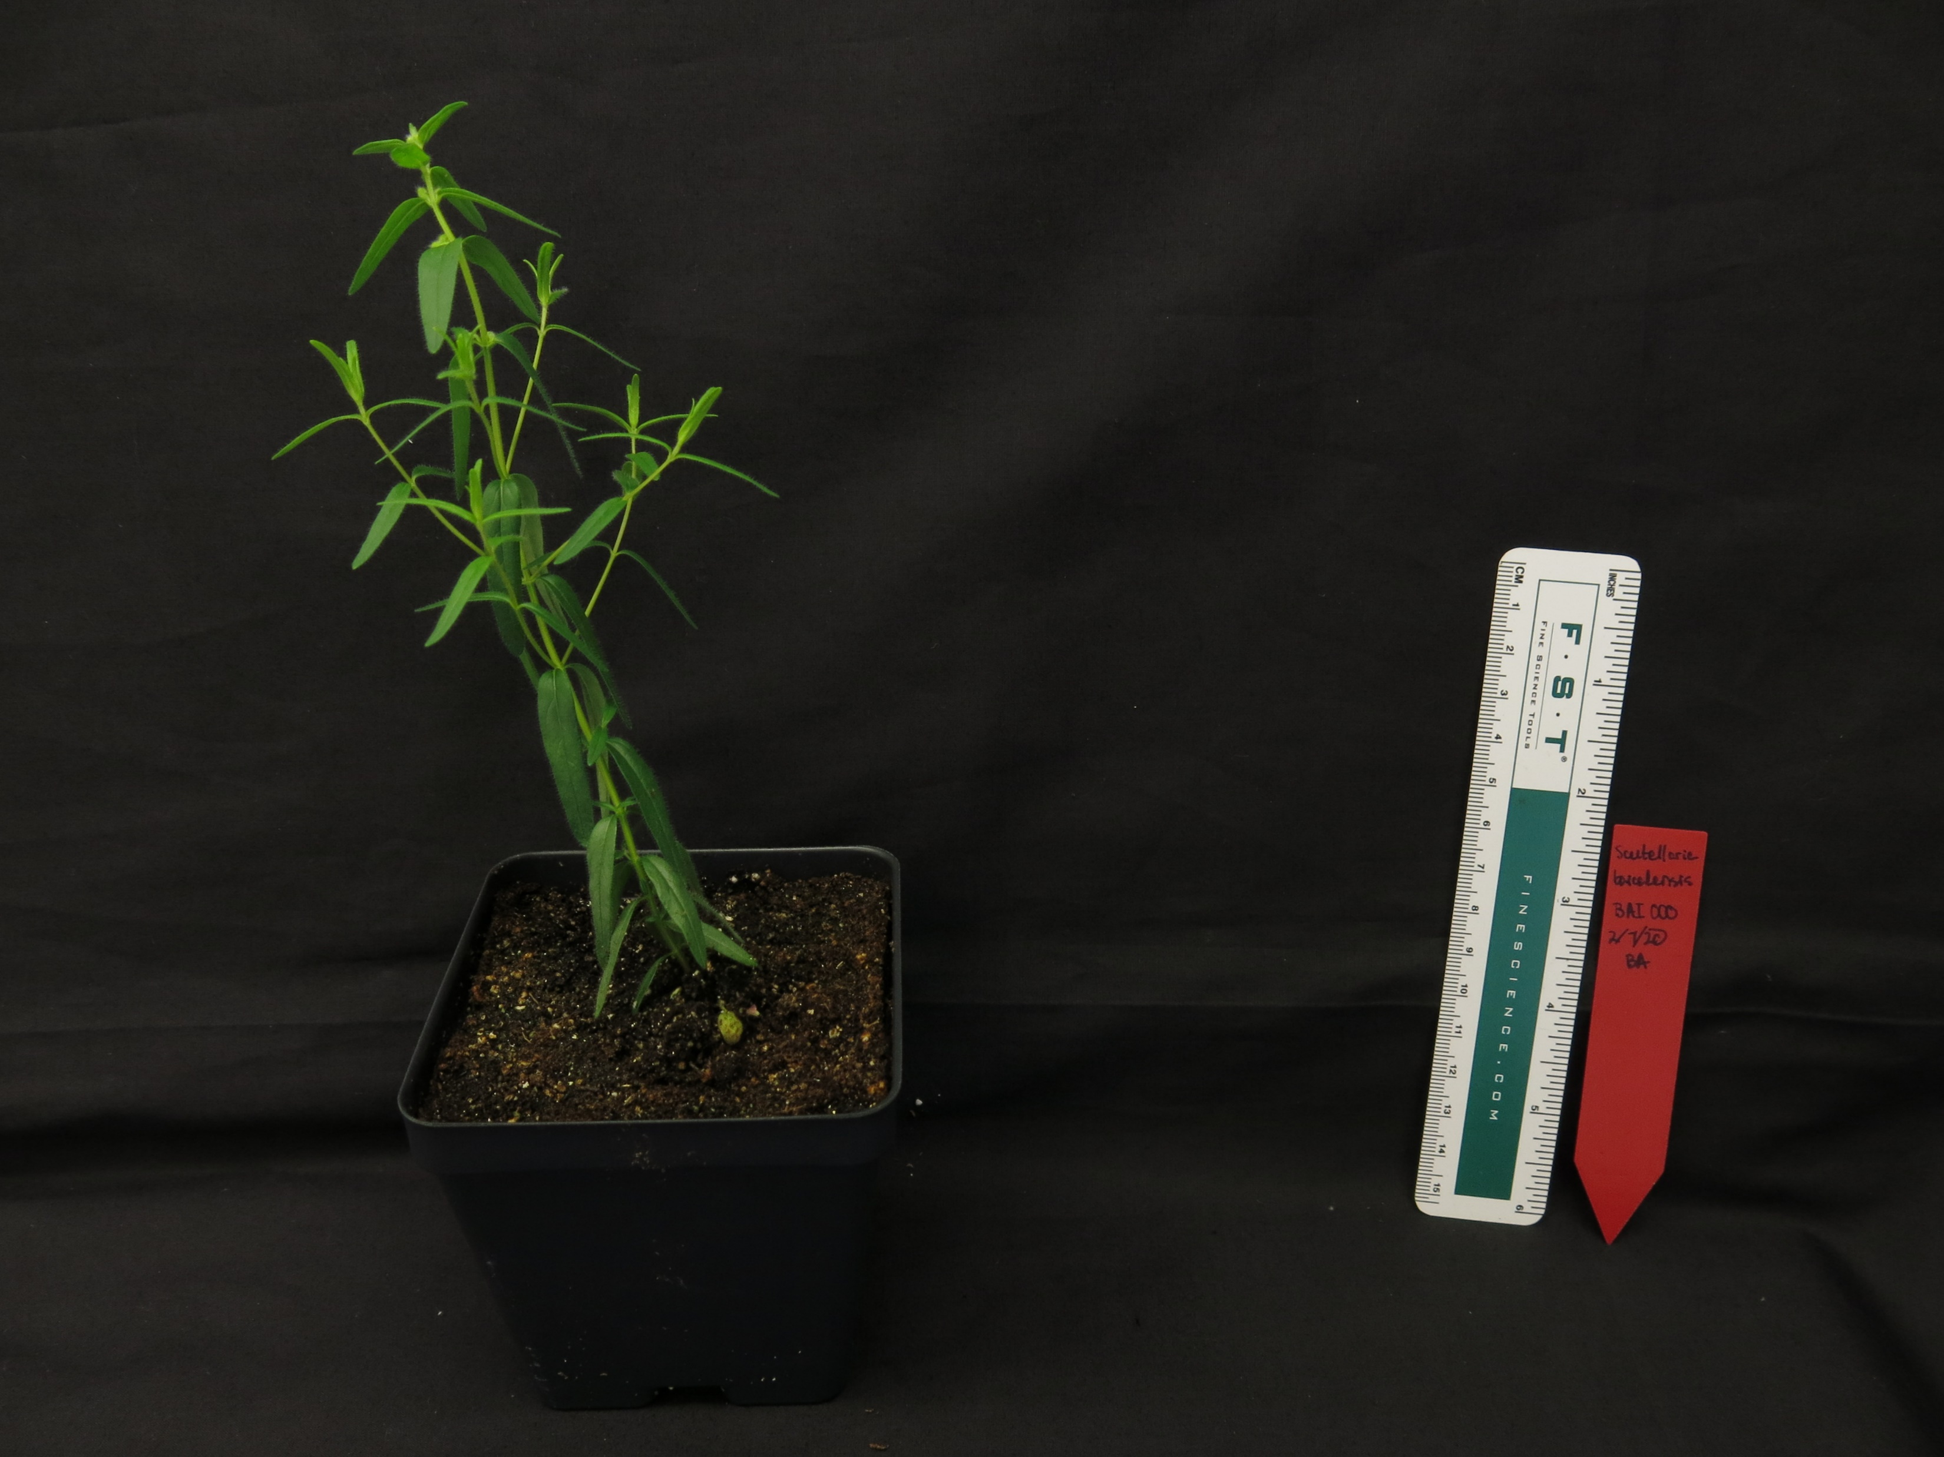
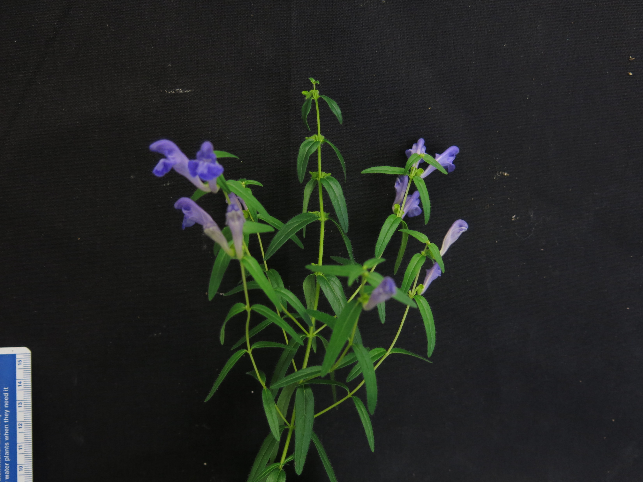
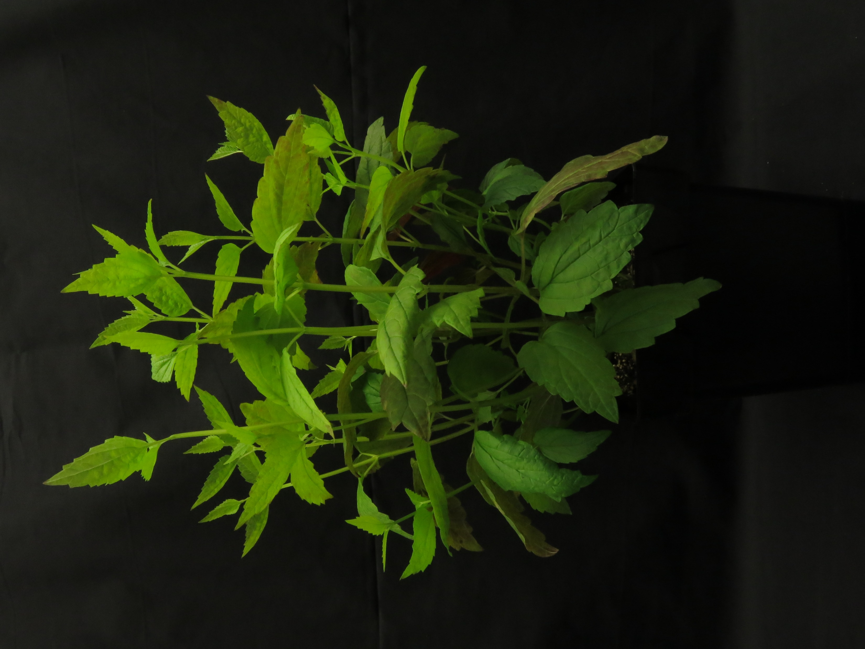
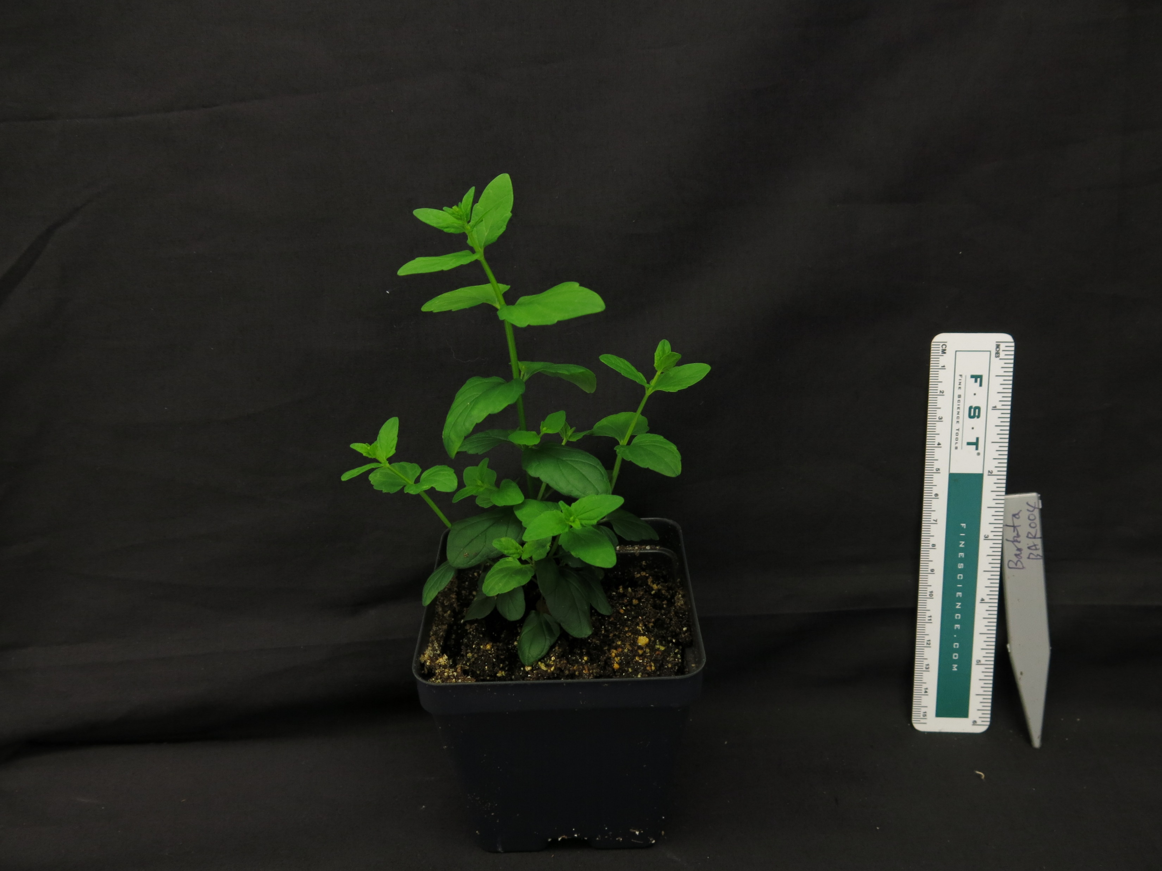
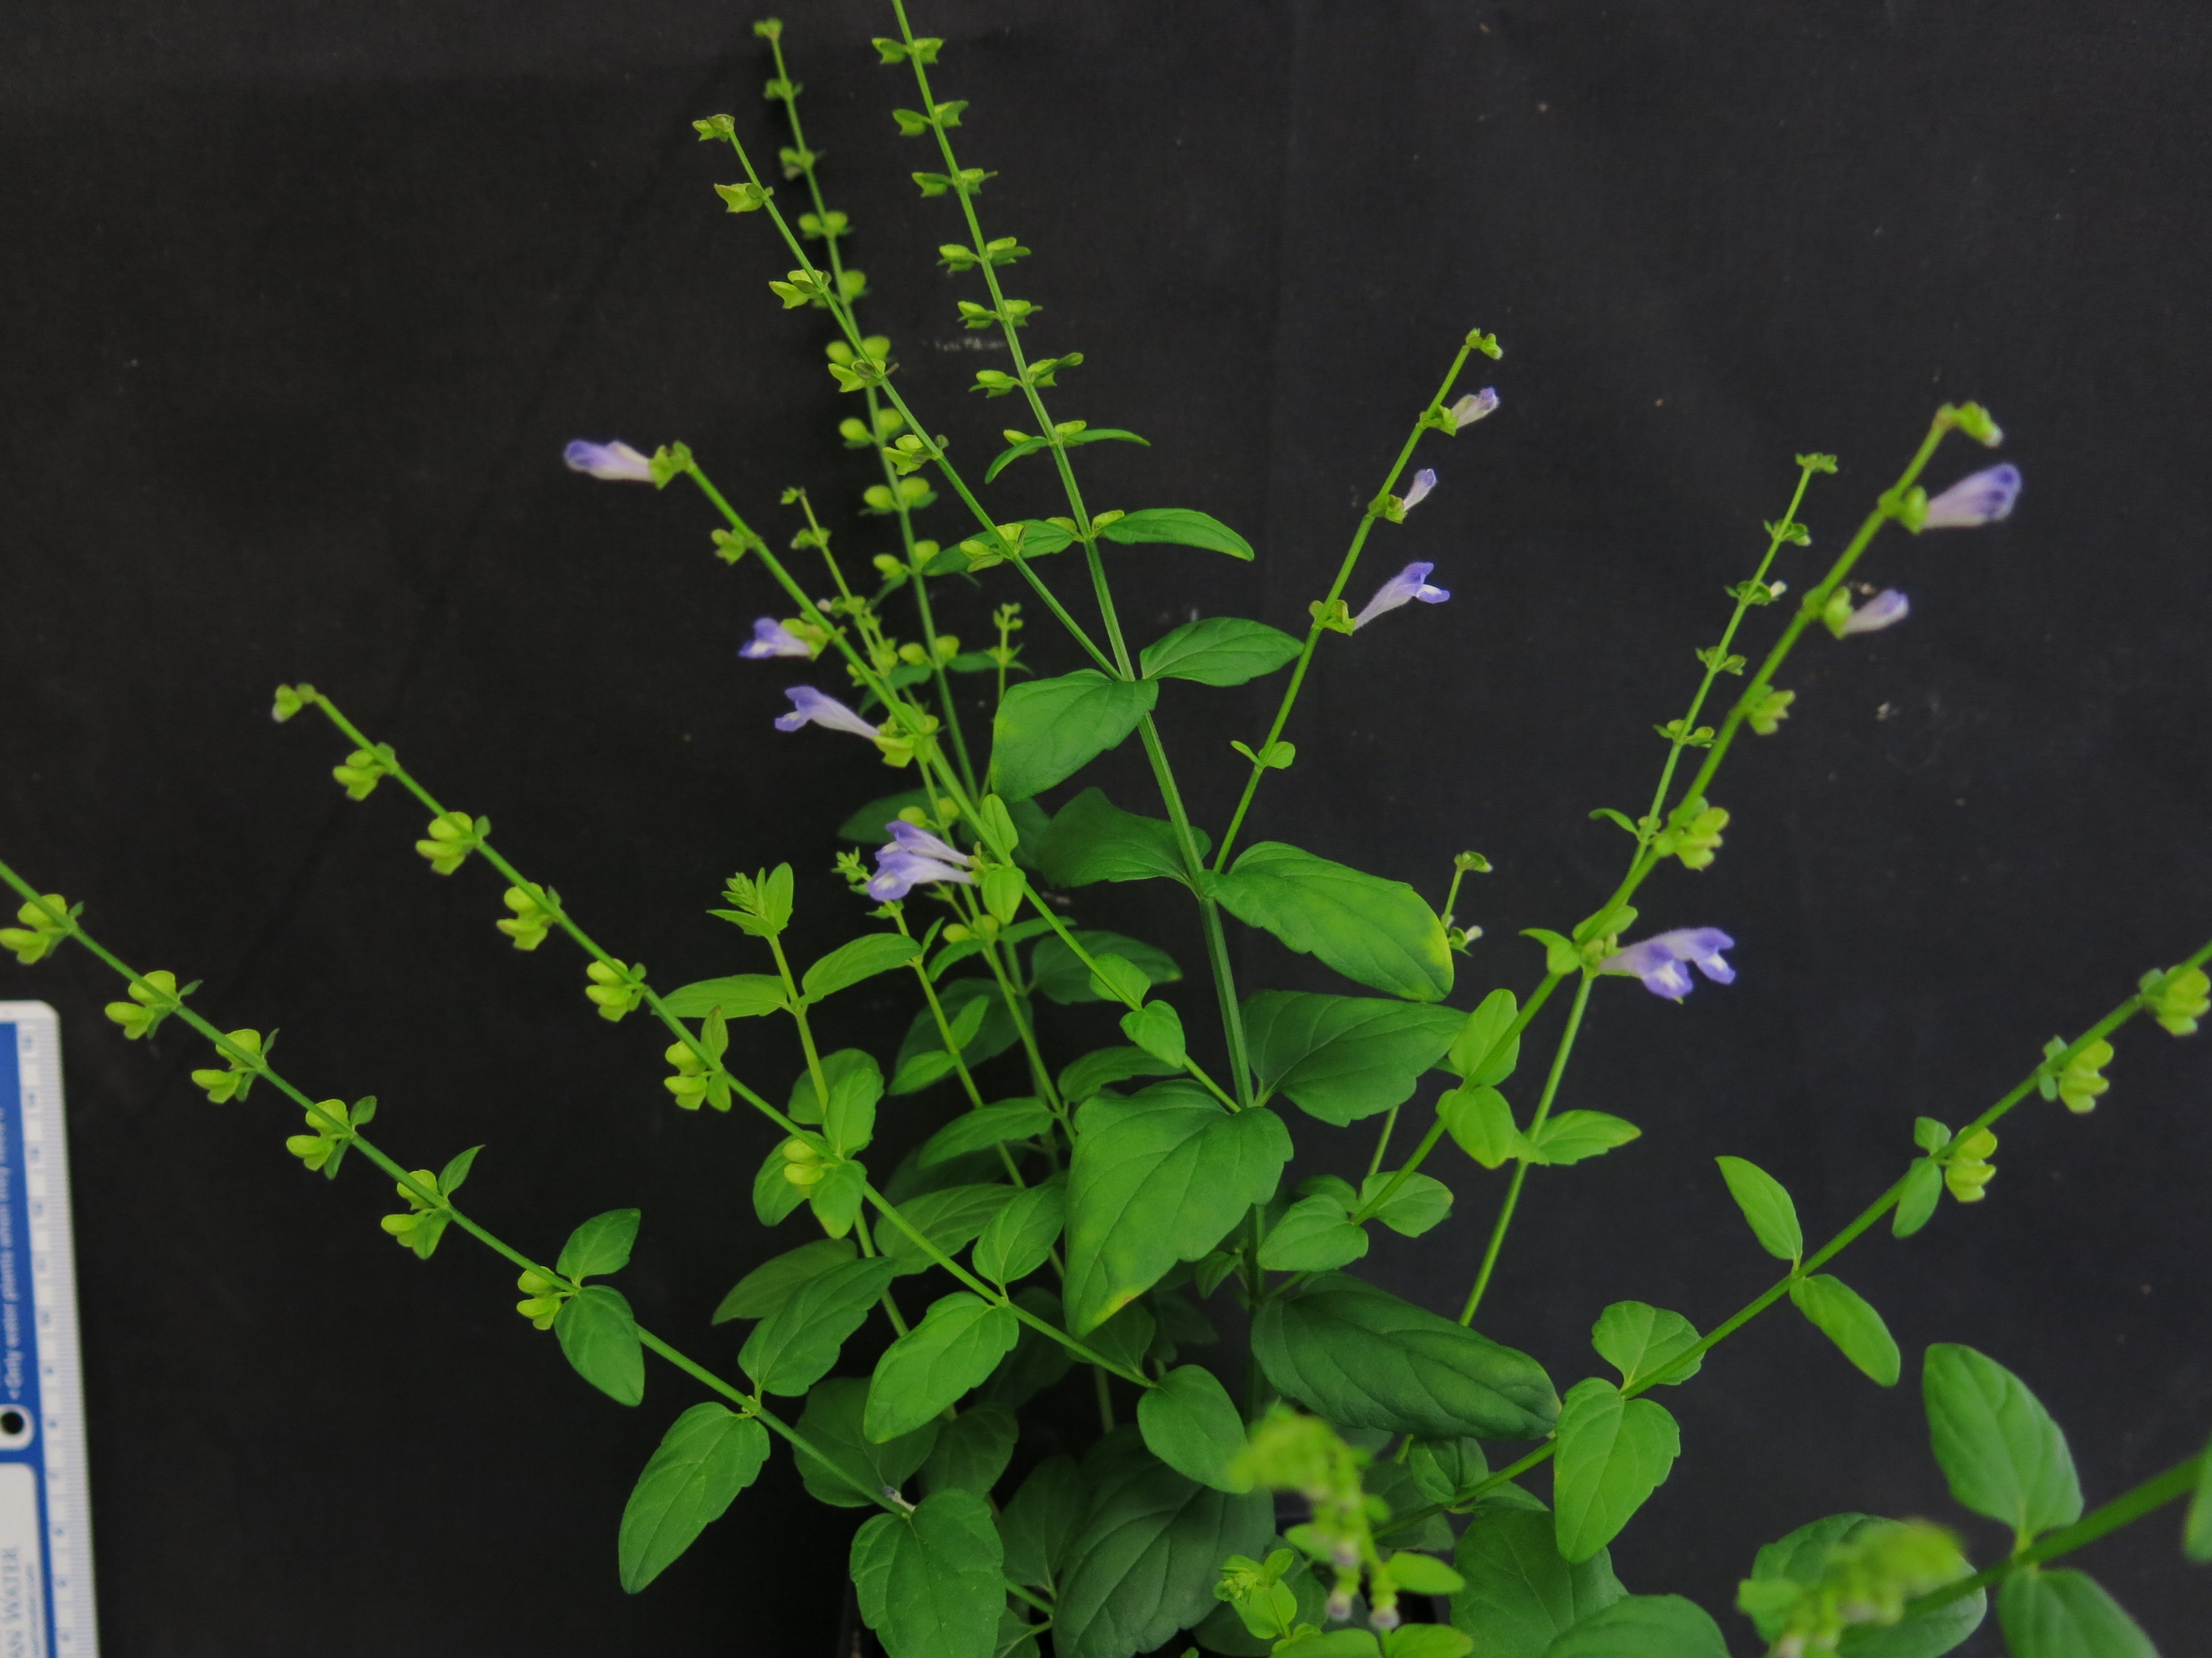
Introduction to the Scutellaria genus
Part of the Lamiaceae family
Rich in medicinal flavonoids
Several species more well-studied because of their medicinal uses
Baicalein | Antitumor, hepatoprotective, & more
Wogonin | Anti-inflammatory, anxiolytic, & more
Oroxylin A | Neuroprotective, & anti-RSV
Scutellarein | Anti-RSV
S. baicalensis
S. lateriflora
S. barbata

Slide 3
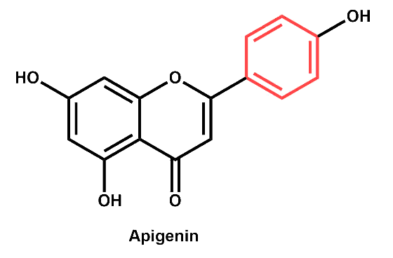
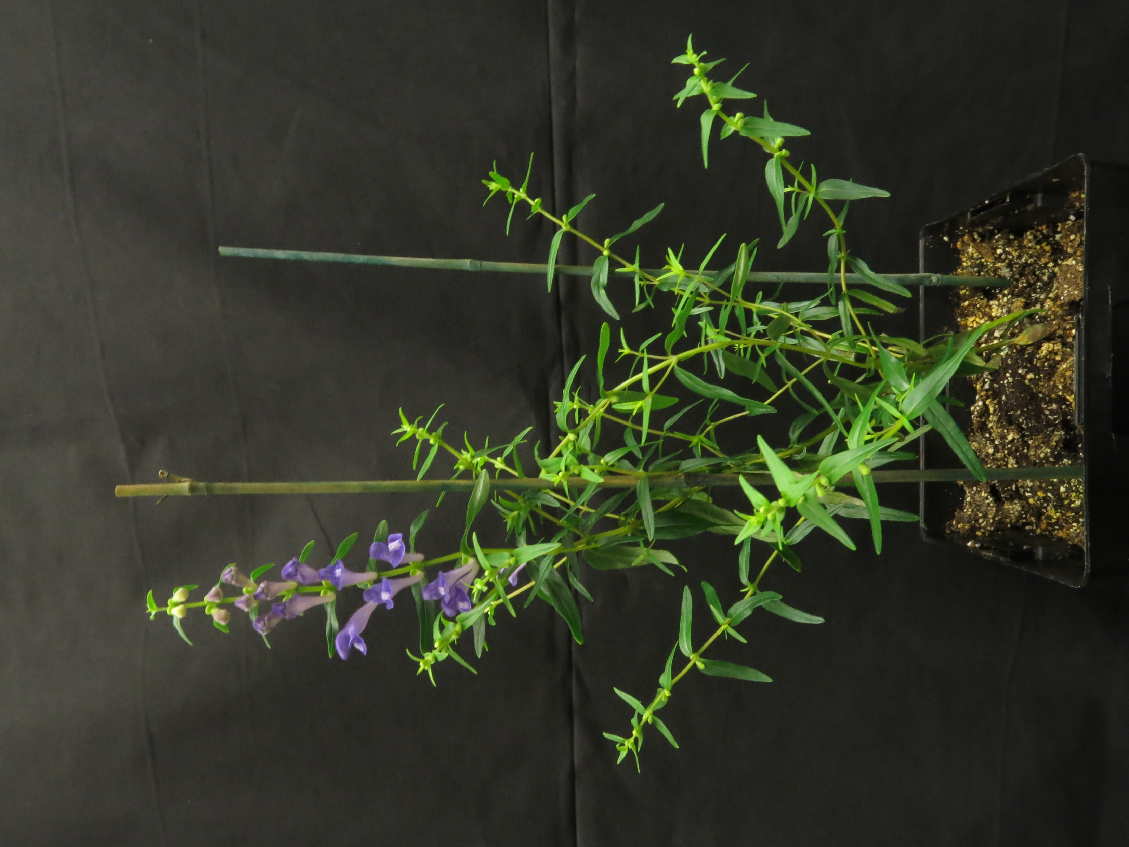
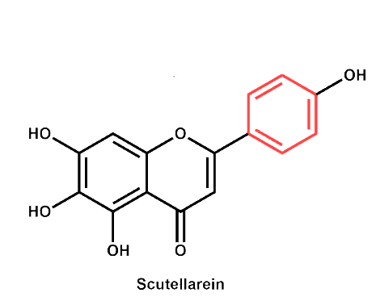
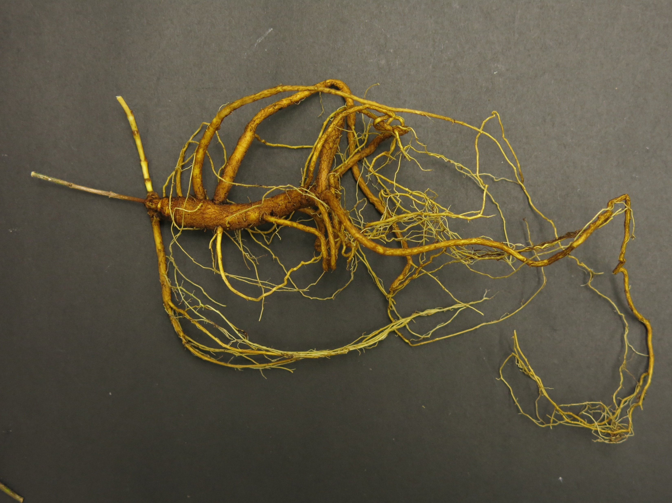
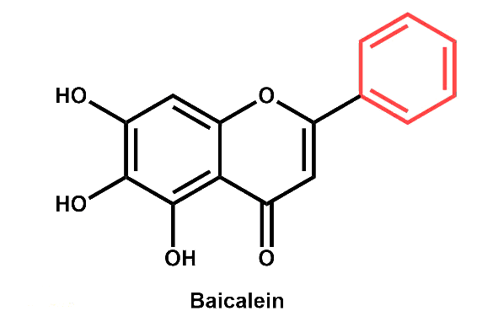
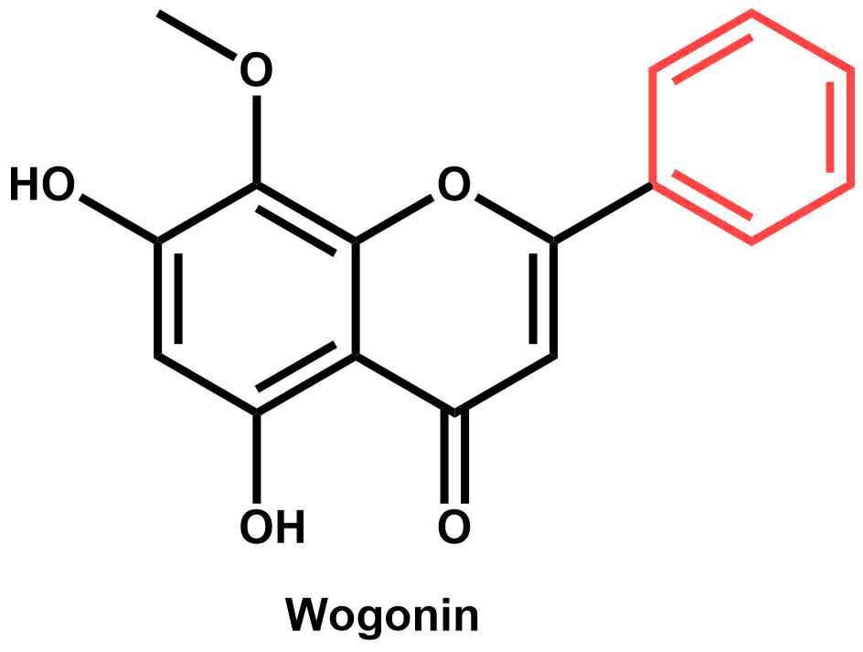
Scutellaria baicalensis
Apigenin
Most famous species
Used often in Chinese medicine – Huang Qin
Unique flavonoid profiles observed
Some specific to roots, and some to shoots
Organ-specific biosynthetic pathway proposed by Zhao et al. (2016)
Scutellarein
Baicalein
Wogonin

Slide 4
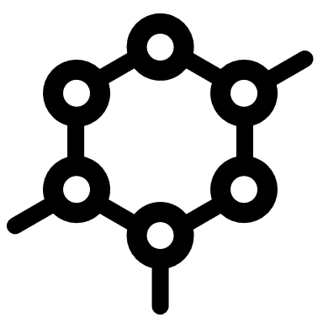


Scutellaria contains >470 species
Extent of flavonoid profile similarity is largely unknown
1) Reveal interspecific differences in
the underlying biosynthetic pathway
An improved
understanding of
2) Better characterize the evolutionary
flavonoid diversity
history of the biosynthetic
pathway
in
Scutellaria
can:
3) Help identify candidate species for
biotechnology applications

Slide 5
Approach
Better understanding of flavonoid diversity in Scutellaria
Phylogenetic analysis
1) Sequence chloroplast DNA
2) Construct tree and separate into clades
Chemical analysis
1) Non-organ specific flavonoid profiling
2) Organ specific flavonoid profiling
Genome size analysis
1) Flow cytometry
2) Collect chromosome #s from literature

Slide 6
Approach
Better understanding of flavonoid diversity in Scutellaria
Phylogenetic analysis
1) Sequence chloroplast DNA
2) Construct phylogenetic tree and separate into clades
Chemical analysis
1) Non-organ specific flavonoid profiling
2) Organ specific flavonoid profiling
Genome size analysis
1) Flow cytometry
2) Collect chromosome #s from literature

Slide 7
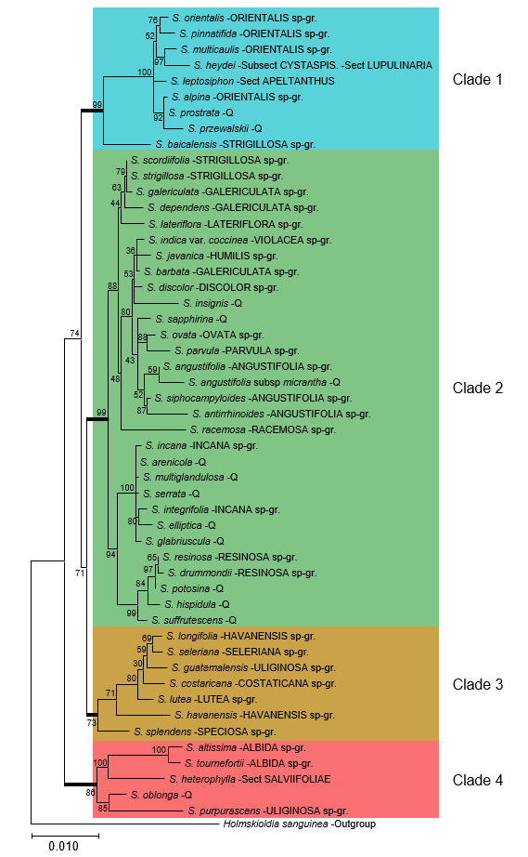
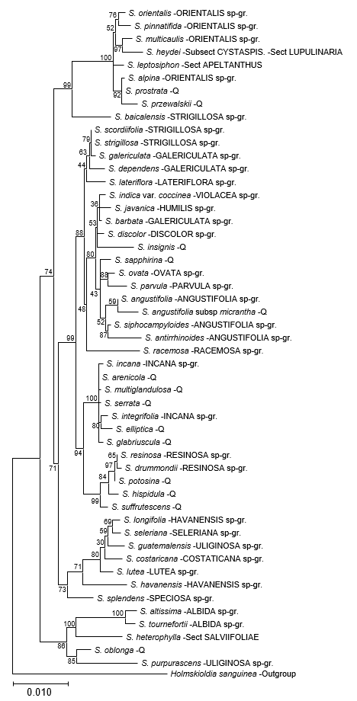
Phylogenetic analysis
Tree constructed from chloroplast sequences of 50 species + 1 outgroup
Both subgenera represented (Scutellaria and Apelthanthus)
22 out of 38 species-groups represented
Separated into 4 clades for downstream comparison

Slide 8
Approach
Better understanding of flavonoid diversity in Scutellaria
Phylogenetic analysis
1) Sequence chloroplast DNA
2) Construct tree and separate into clades
Chemical analysis
1) Non-organ specific flavonoid profiling
2) Organ specific flavonoid profiling
Genome size analysis
1) Flow cytometry
2) Collect chromosome #s from literature

Slide 9
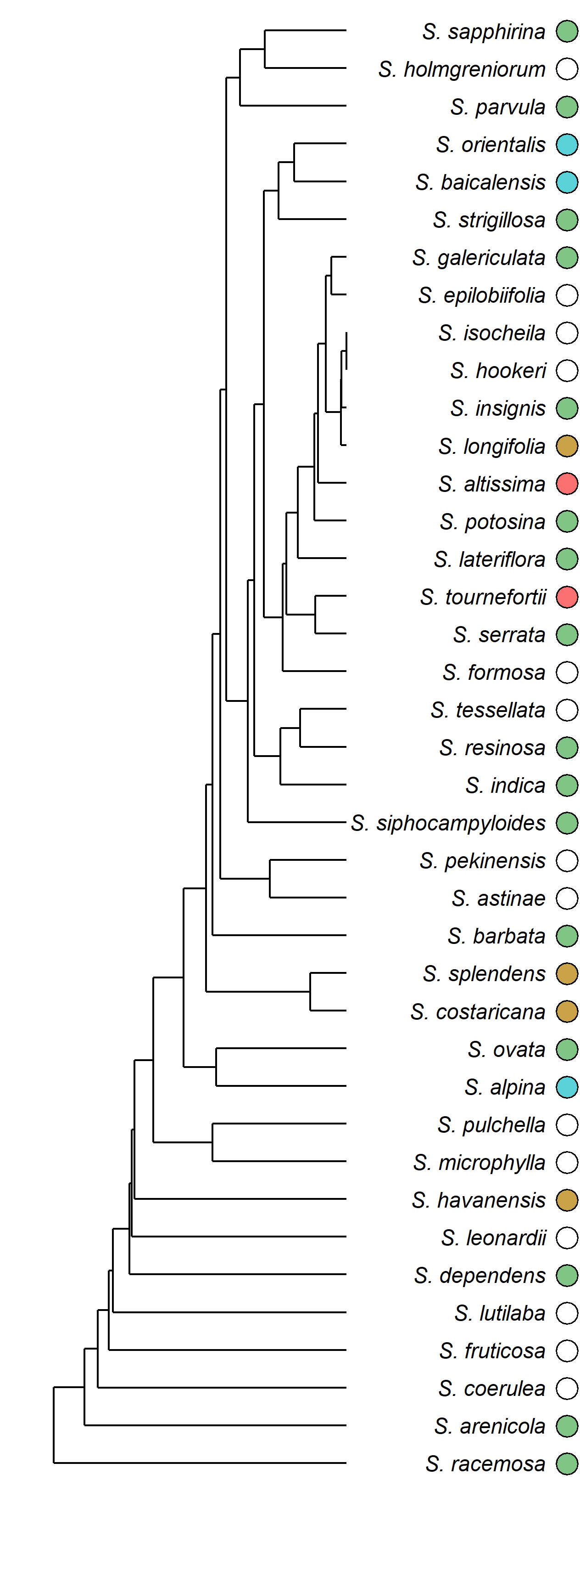
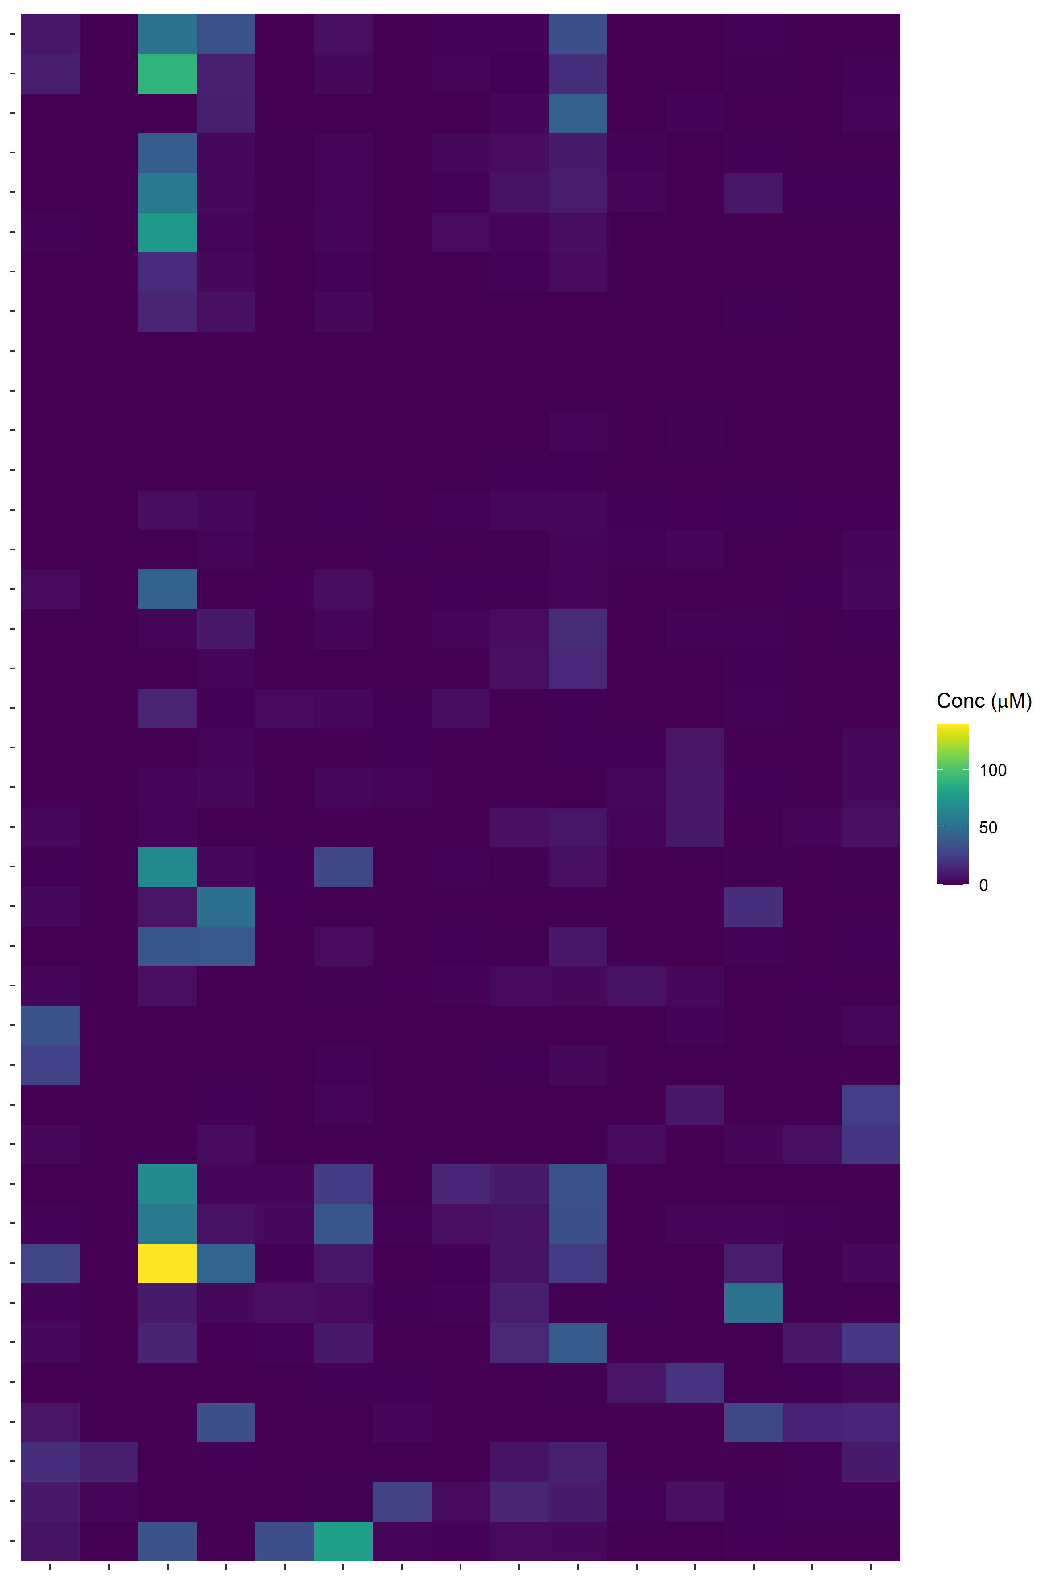
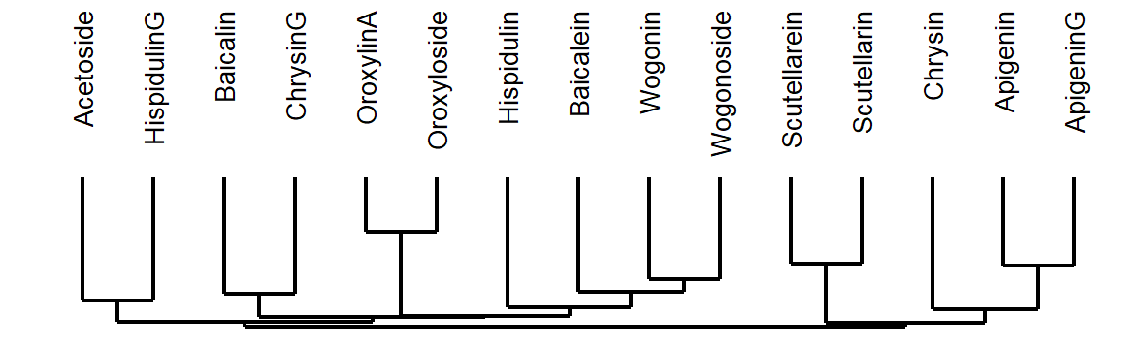
Chemical analysis
39 species selected for targeted profiling via HPLC
Order of species and flavonoids determined by hierarchical clustering
Subset of species selected for organ-specific profiling

Slide 10
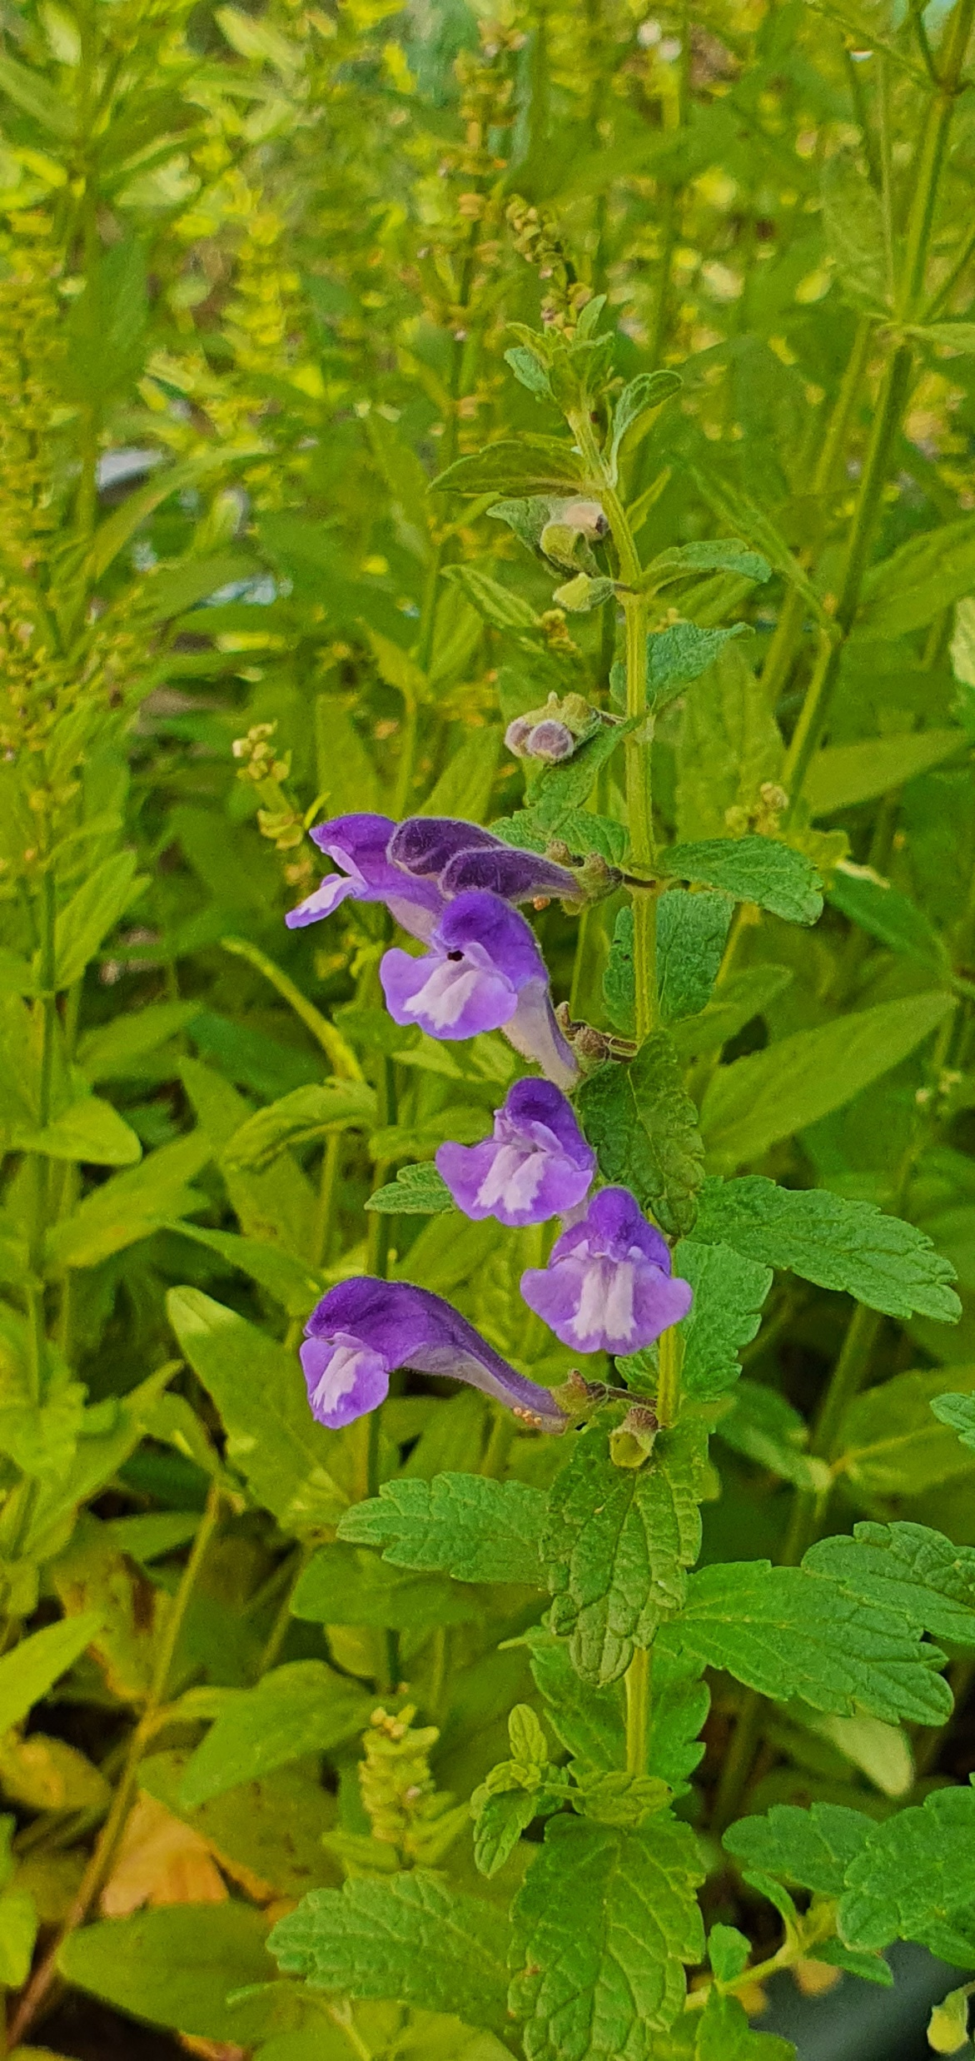
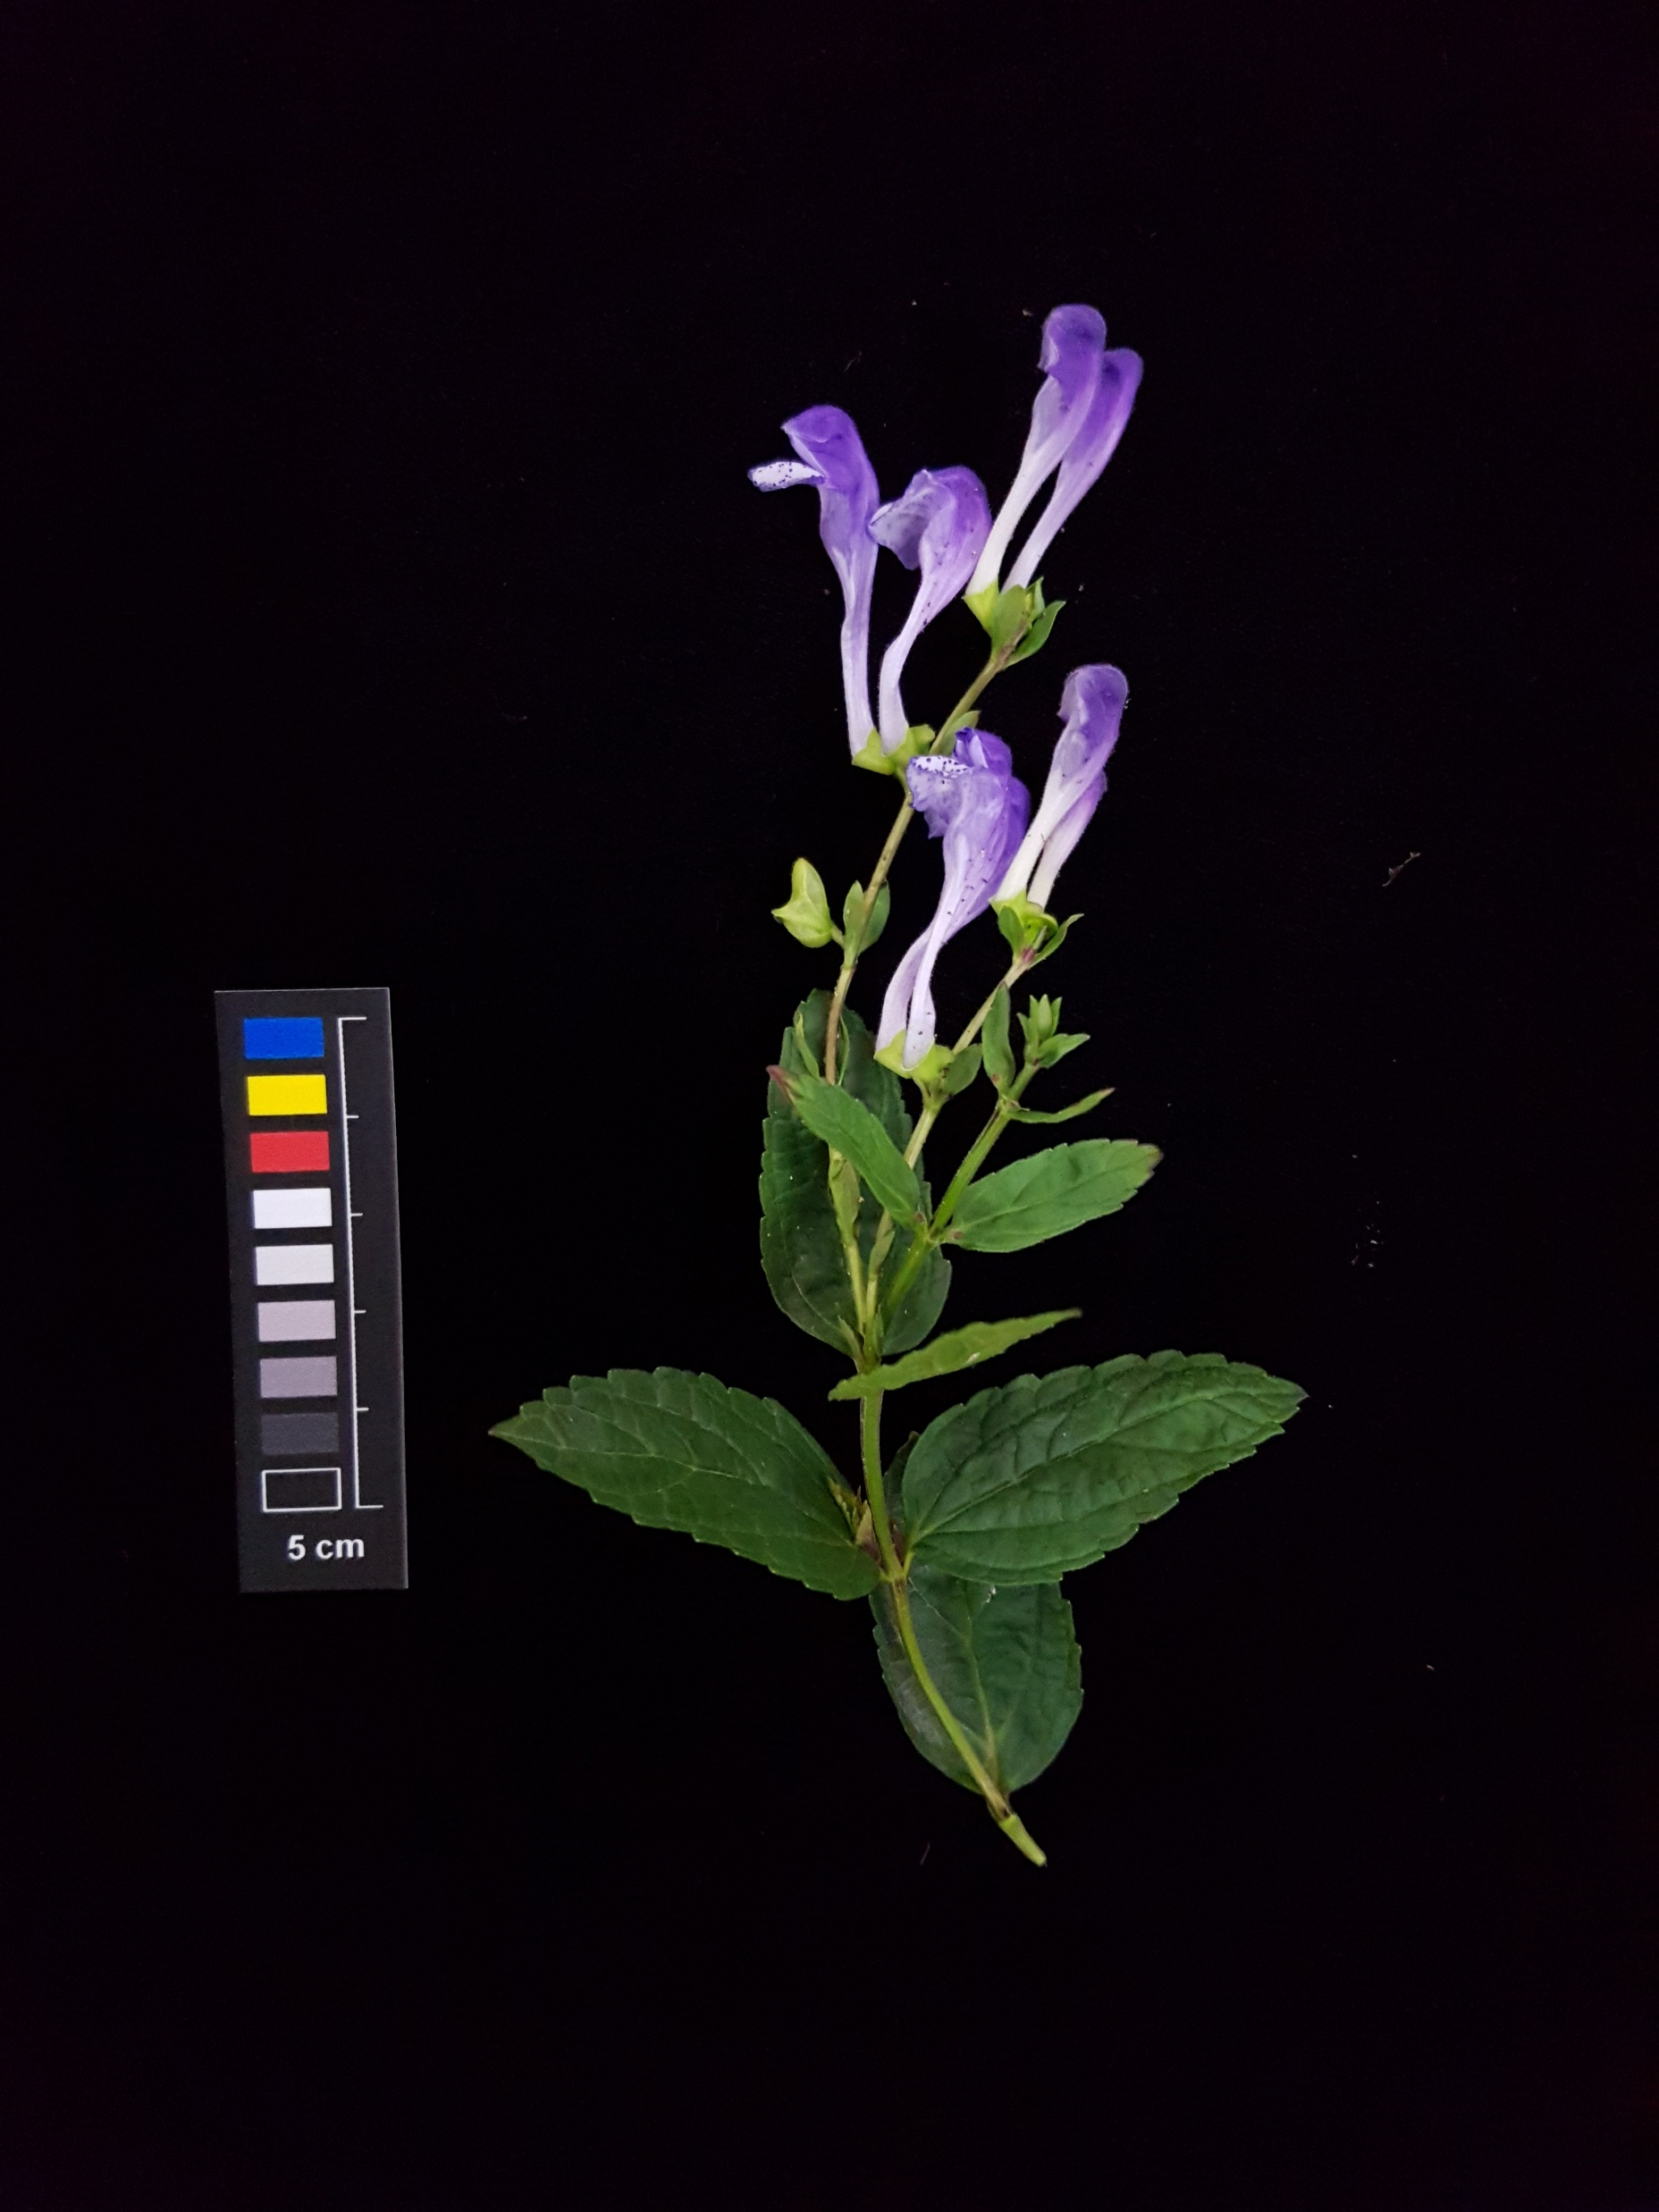
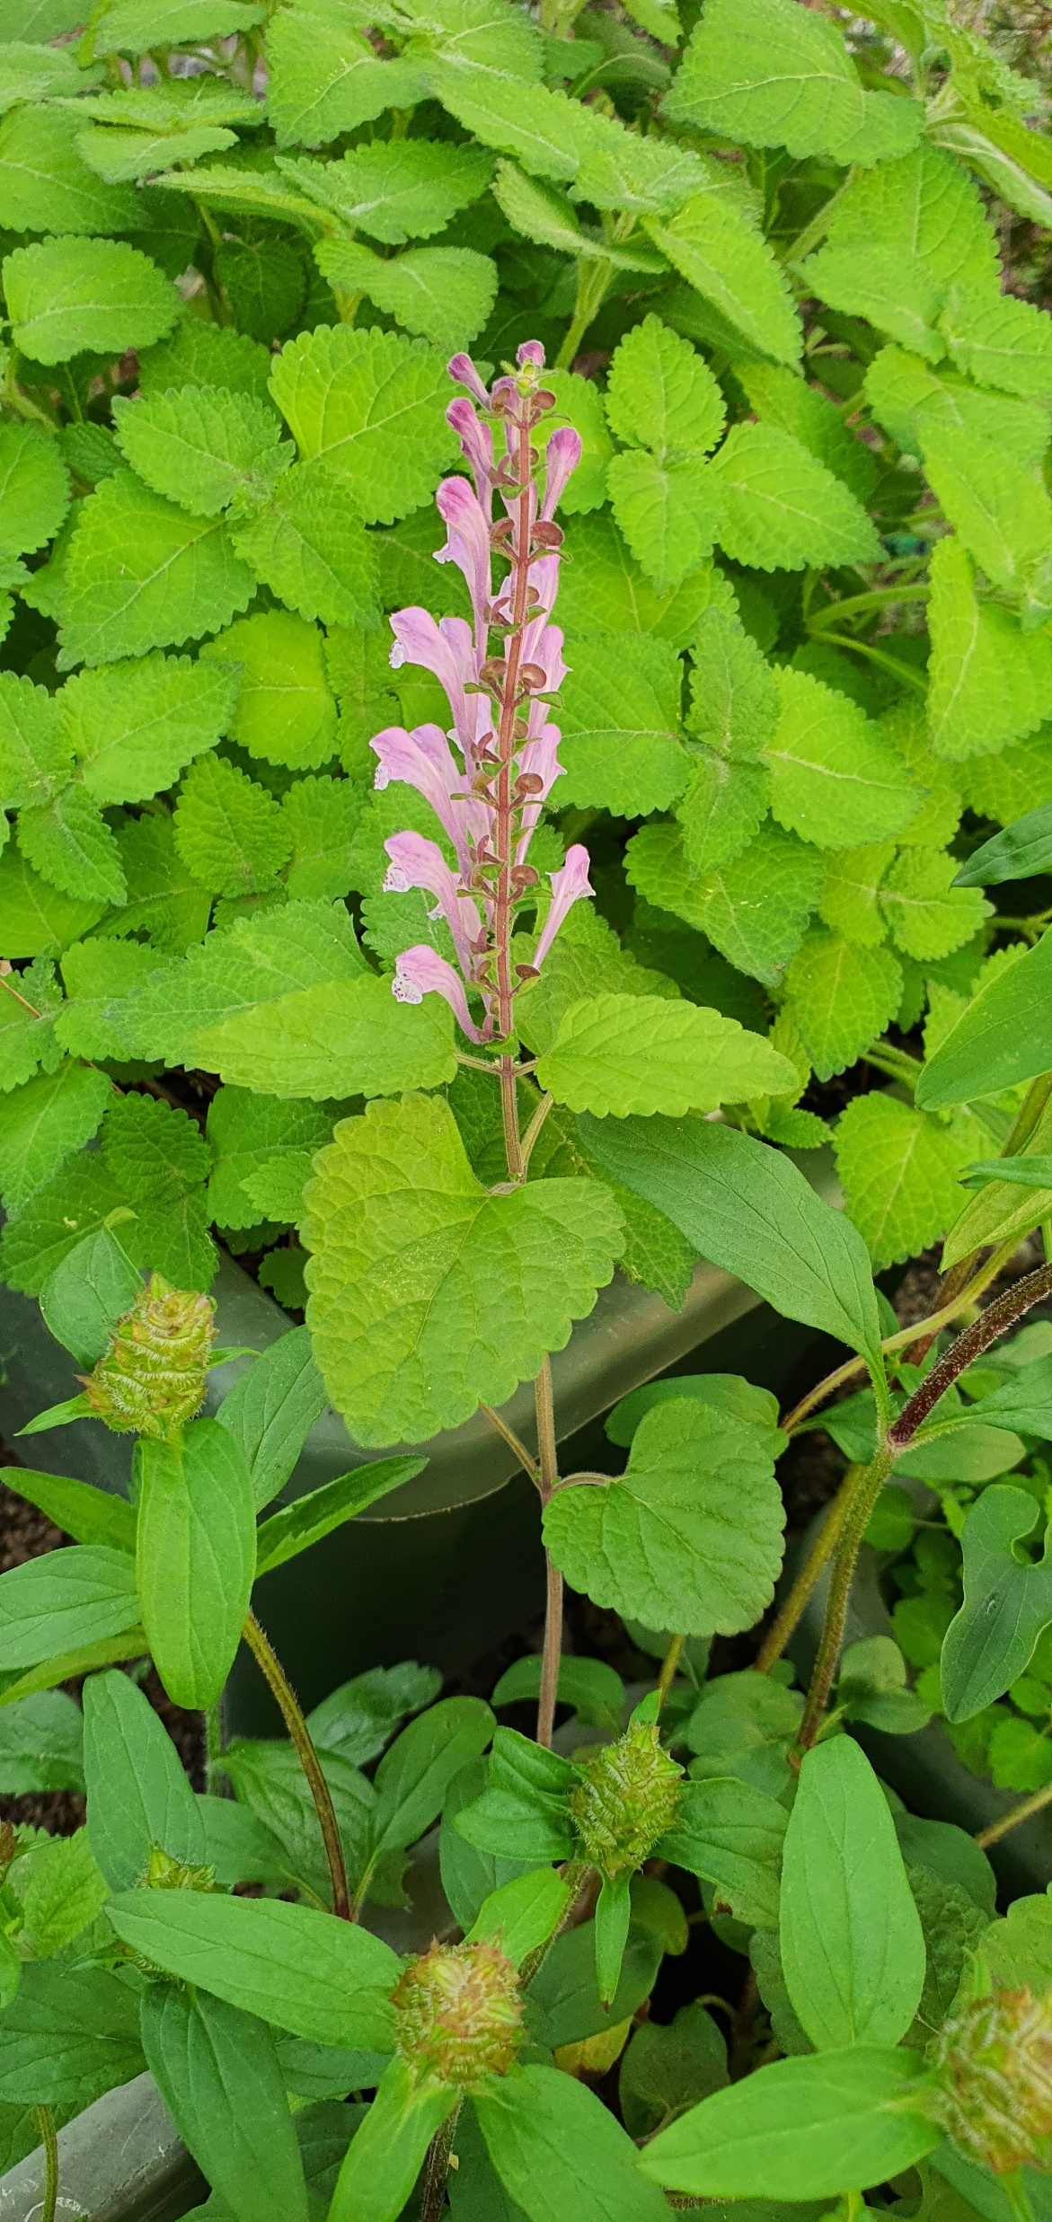
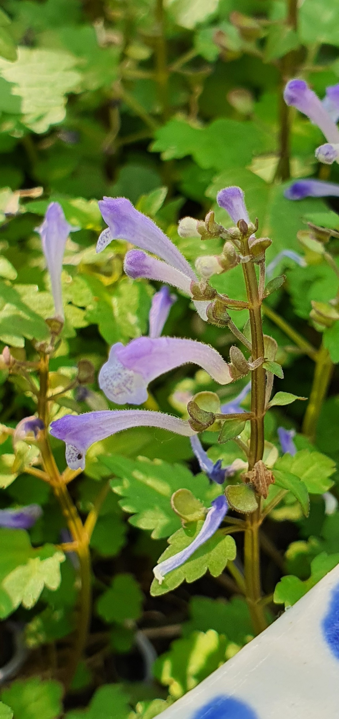
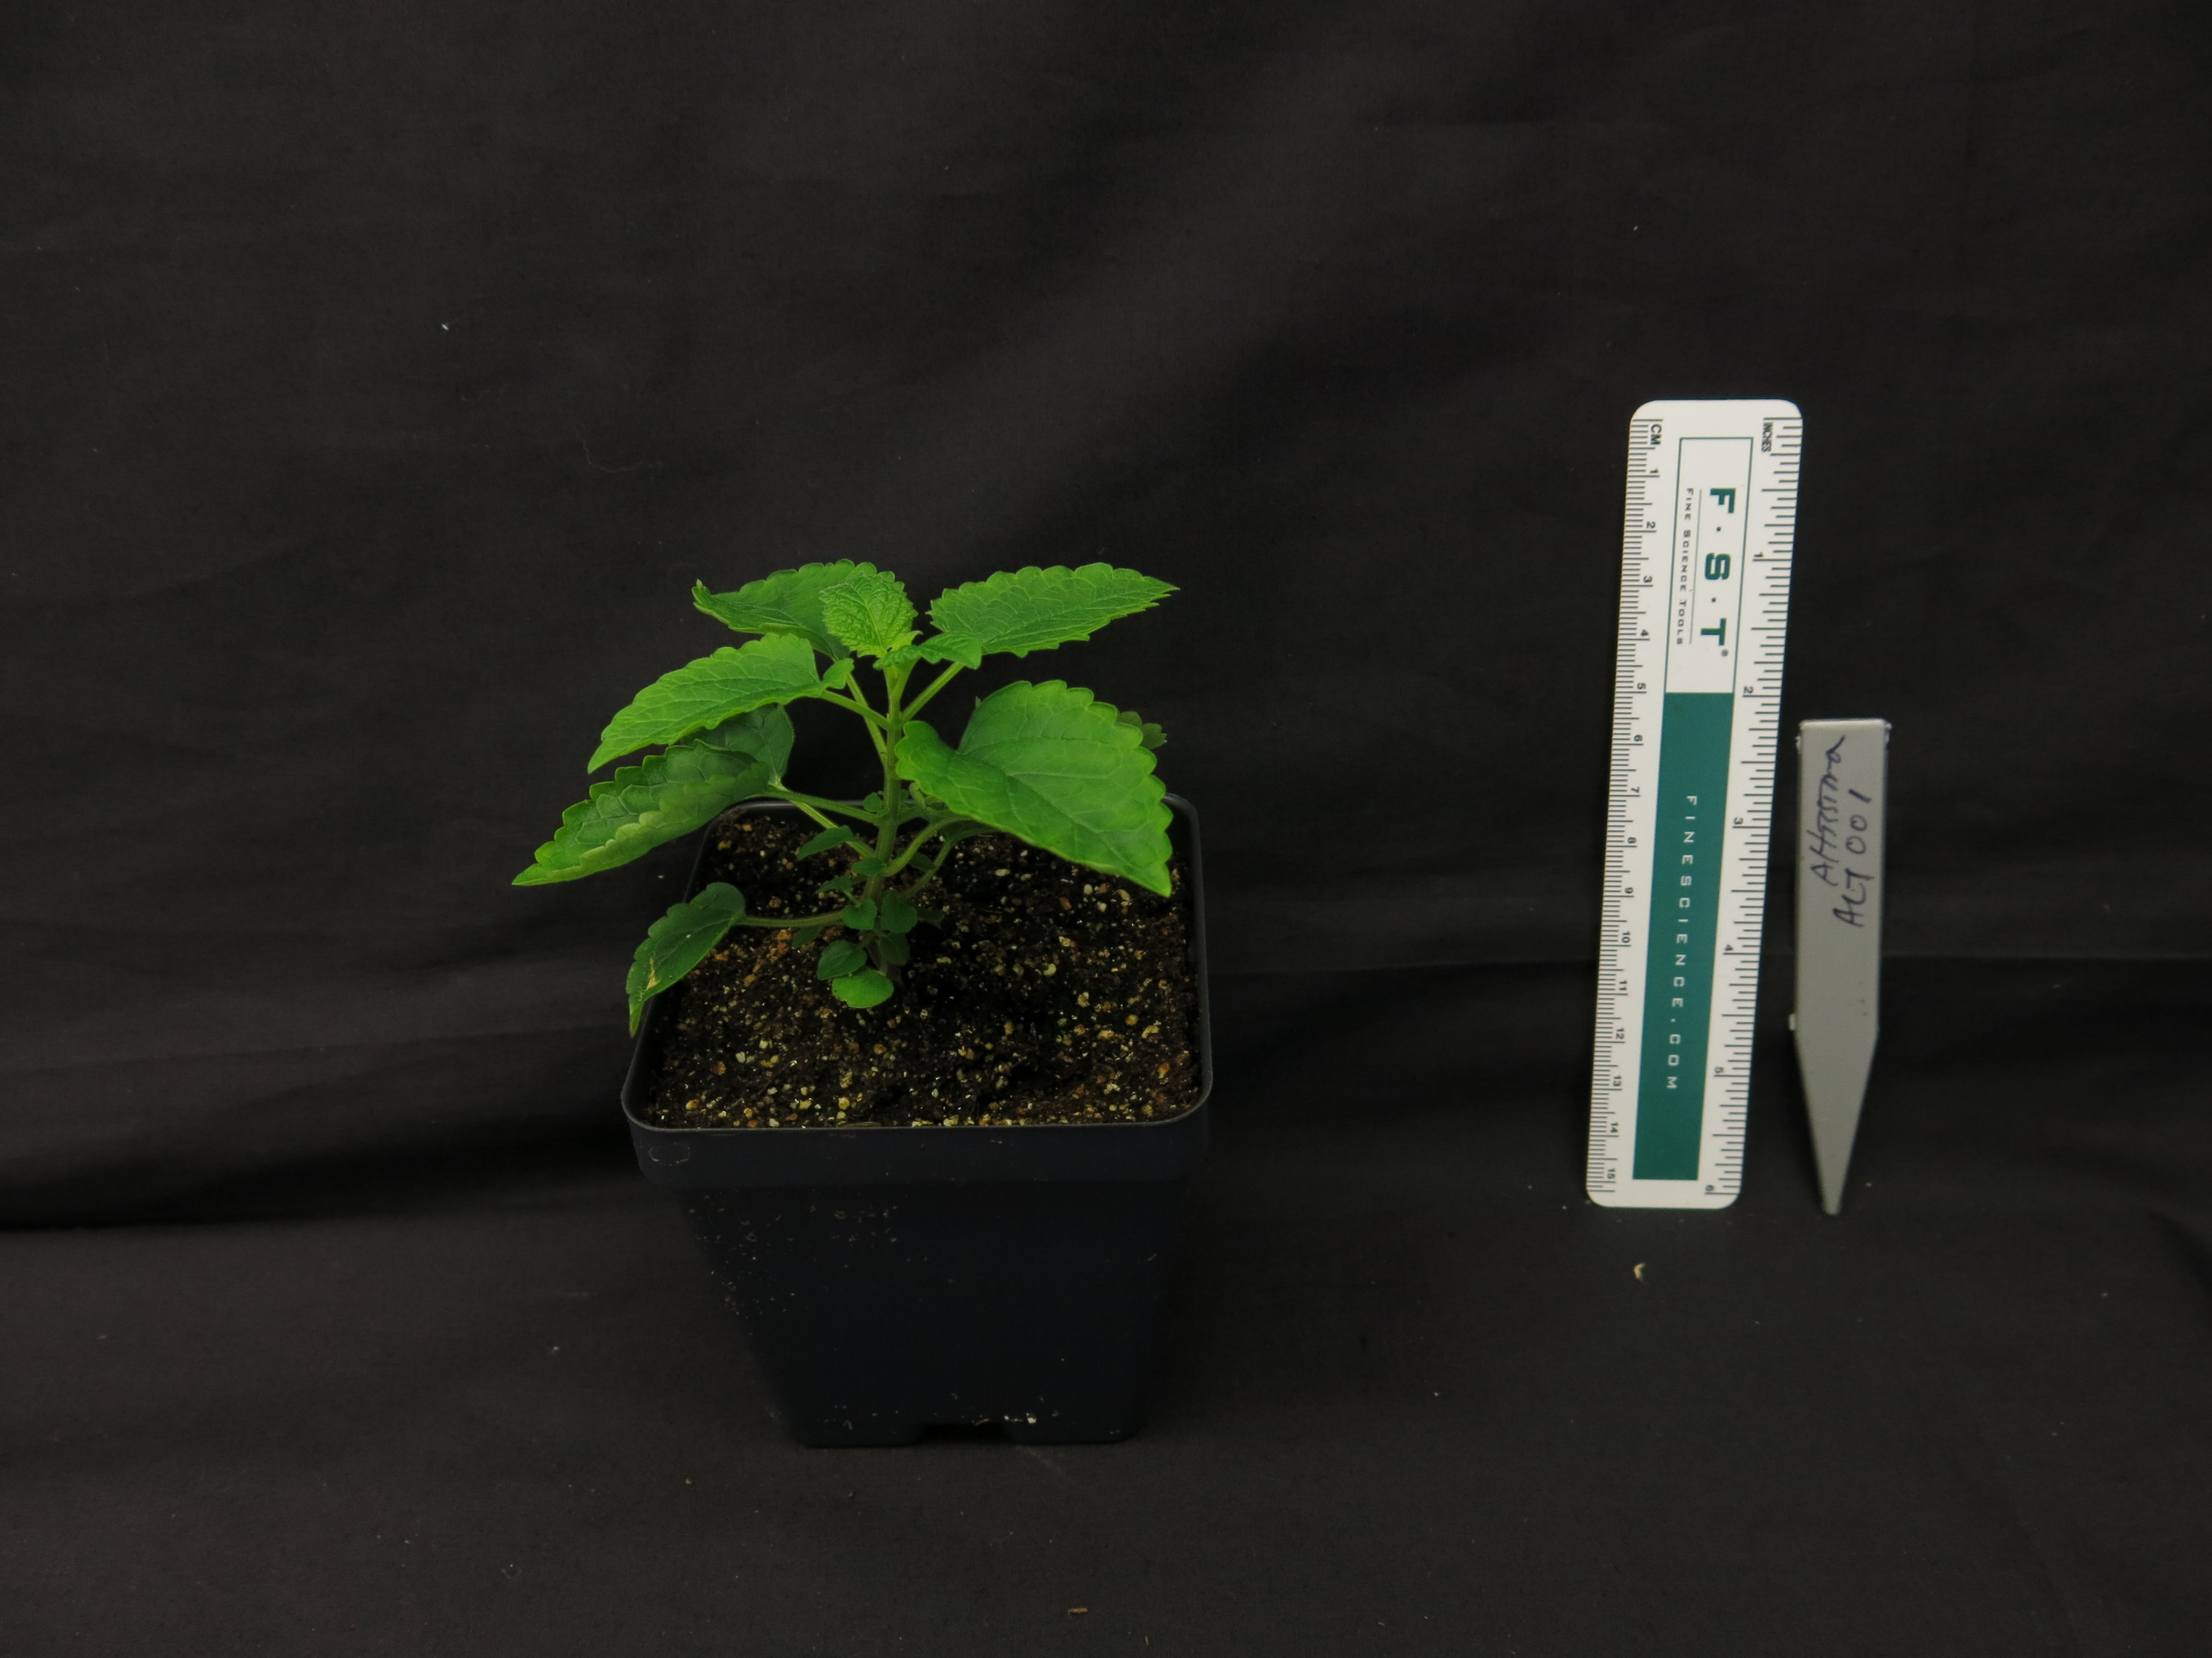
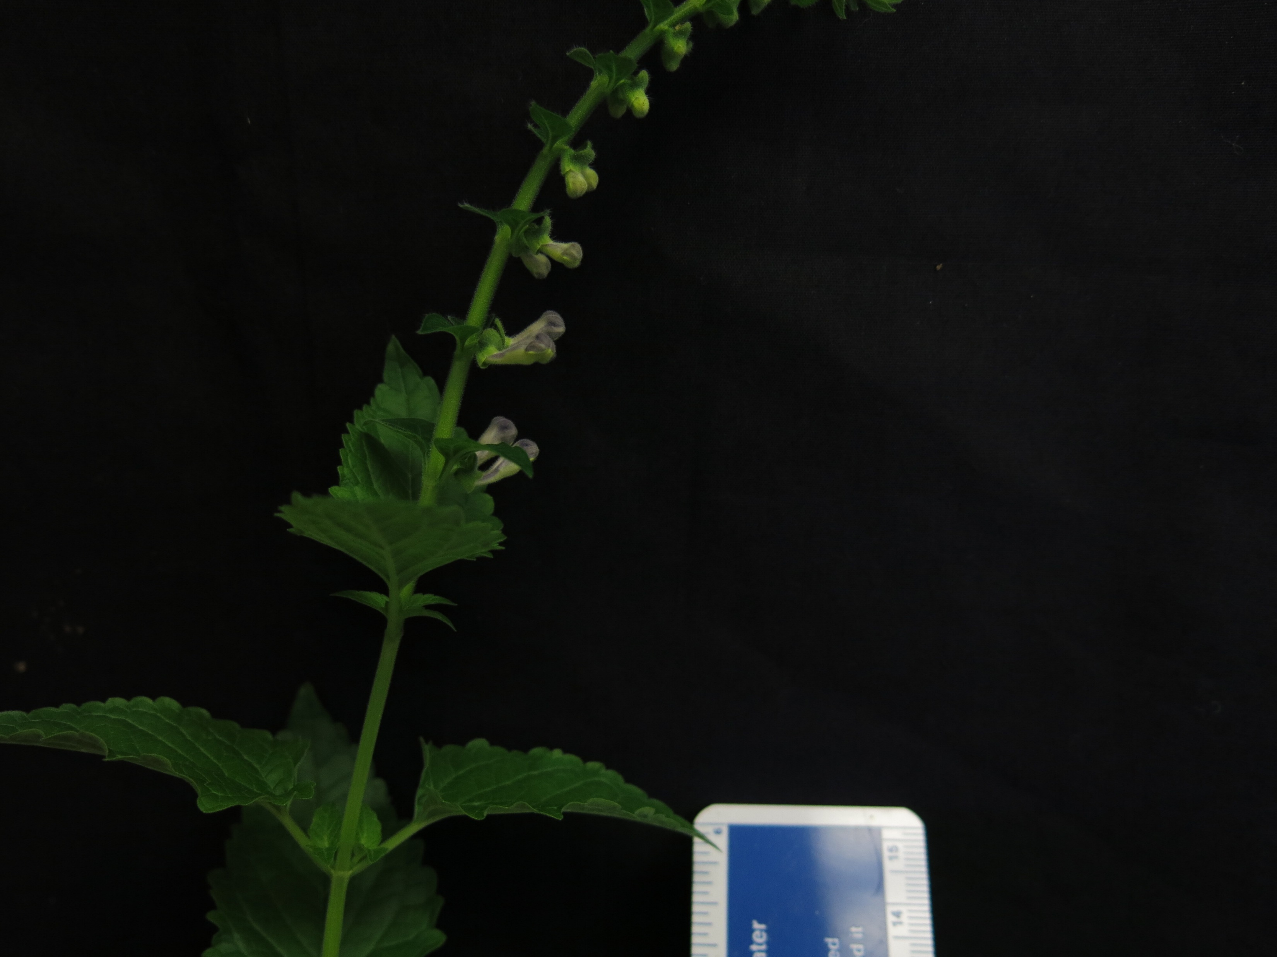
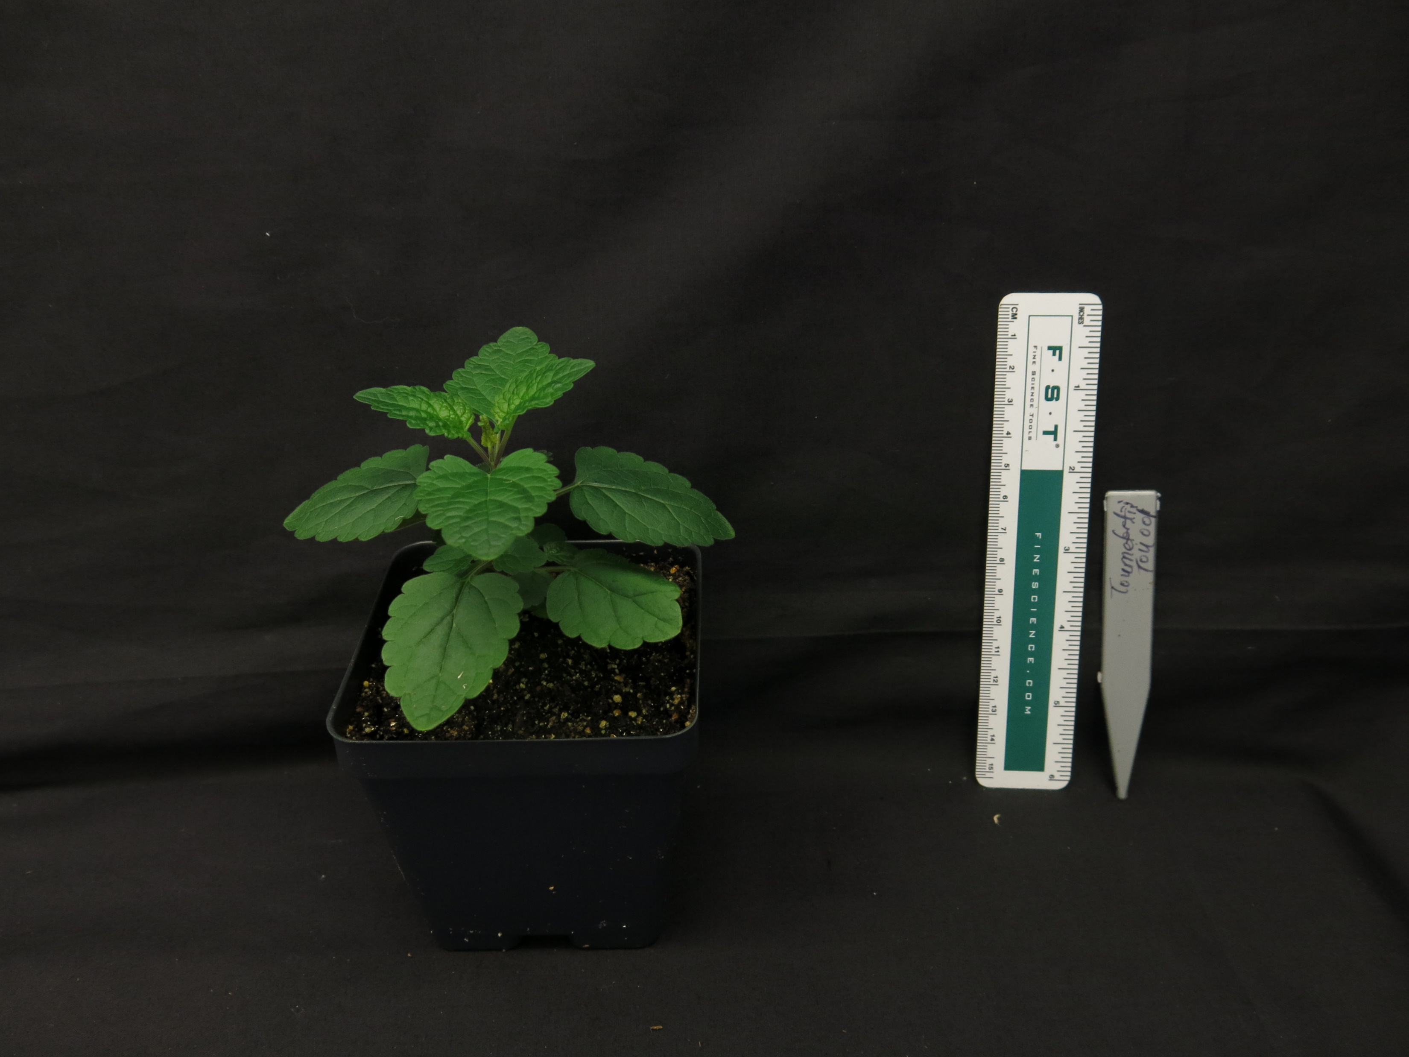
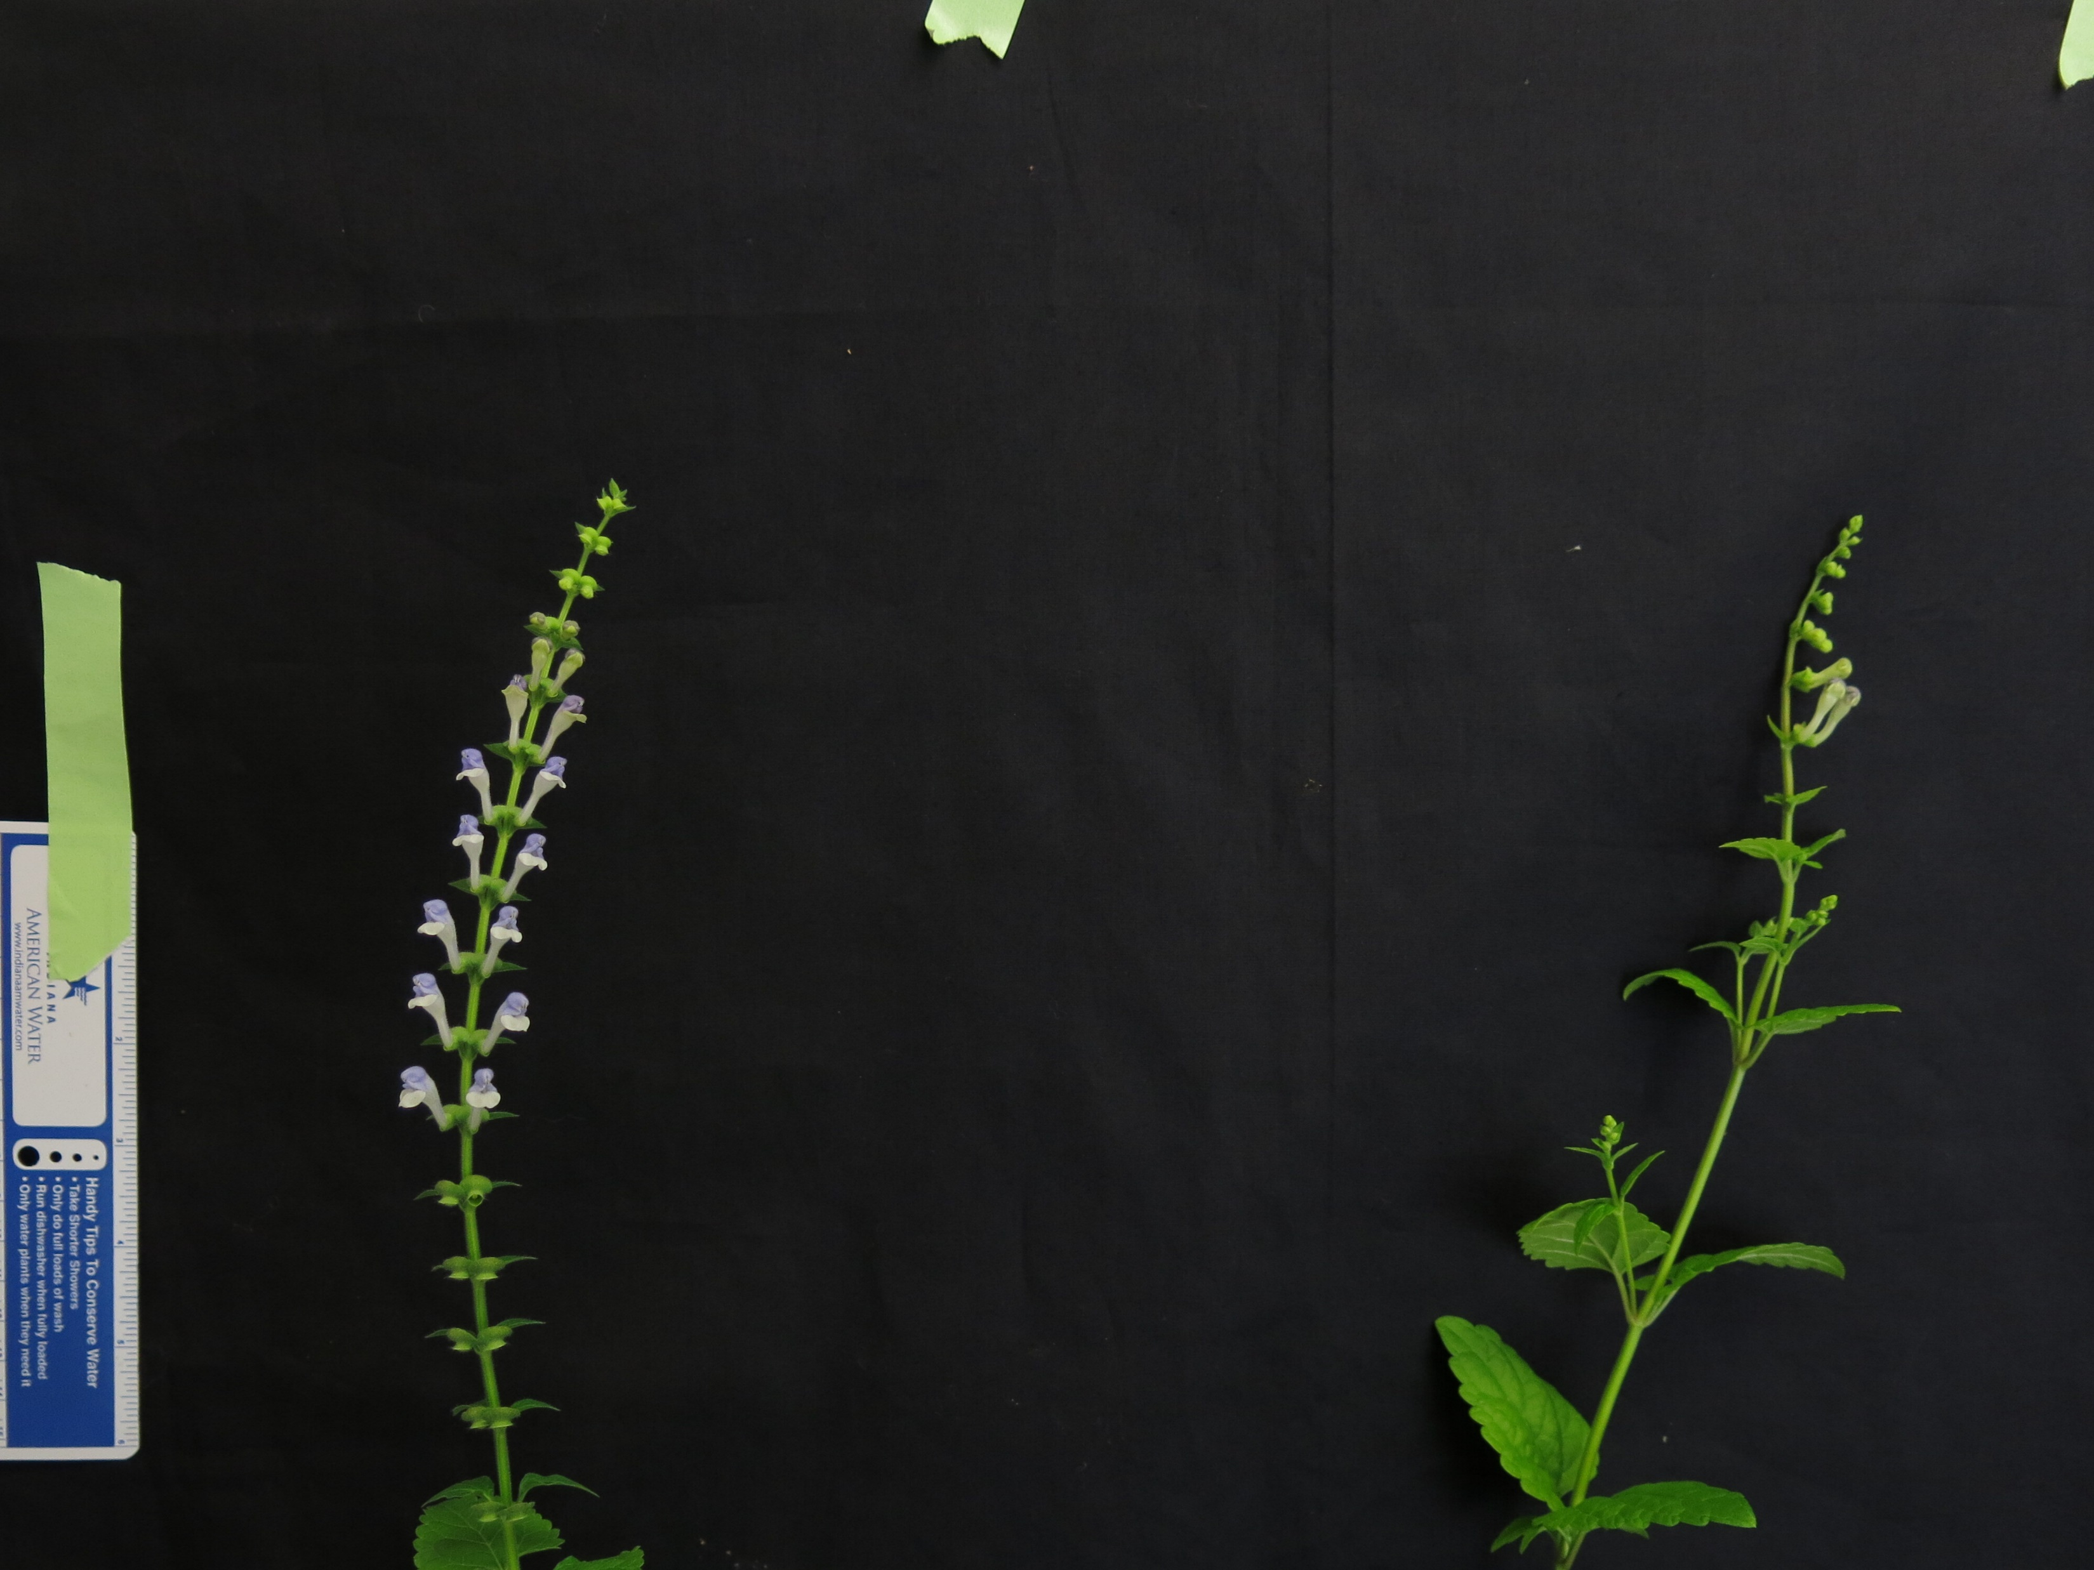
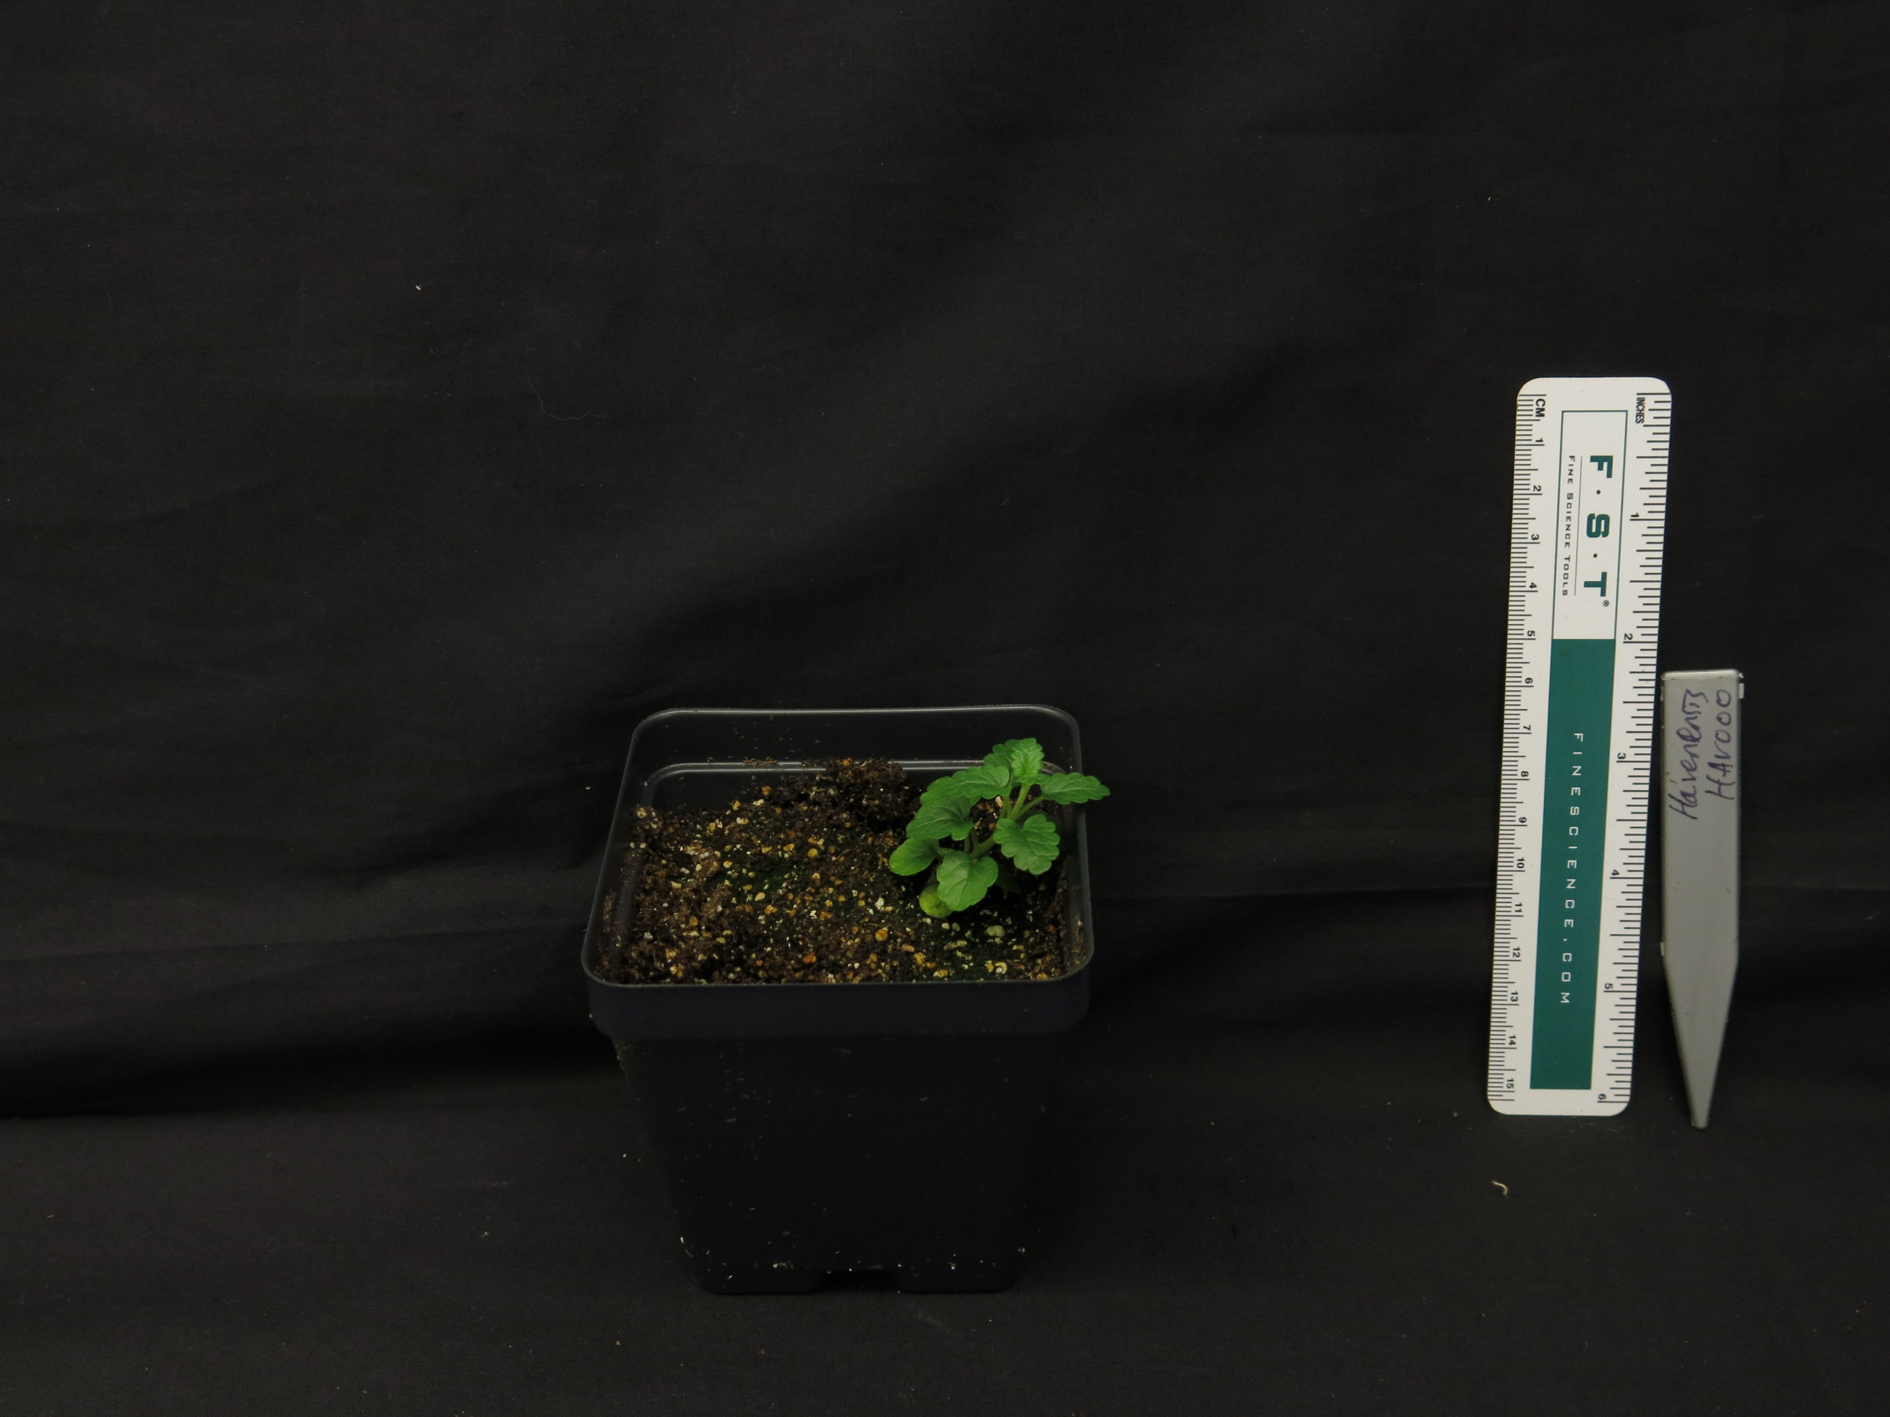
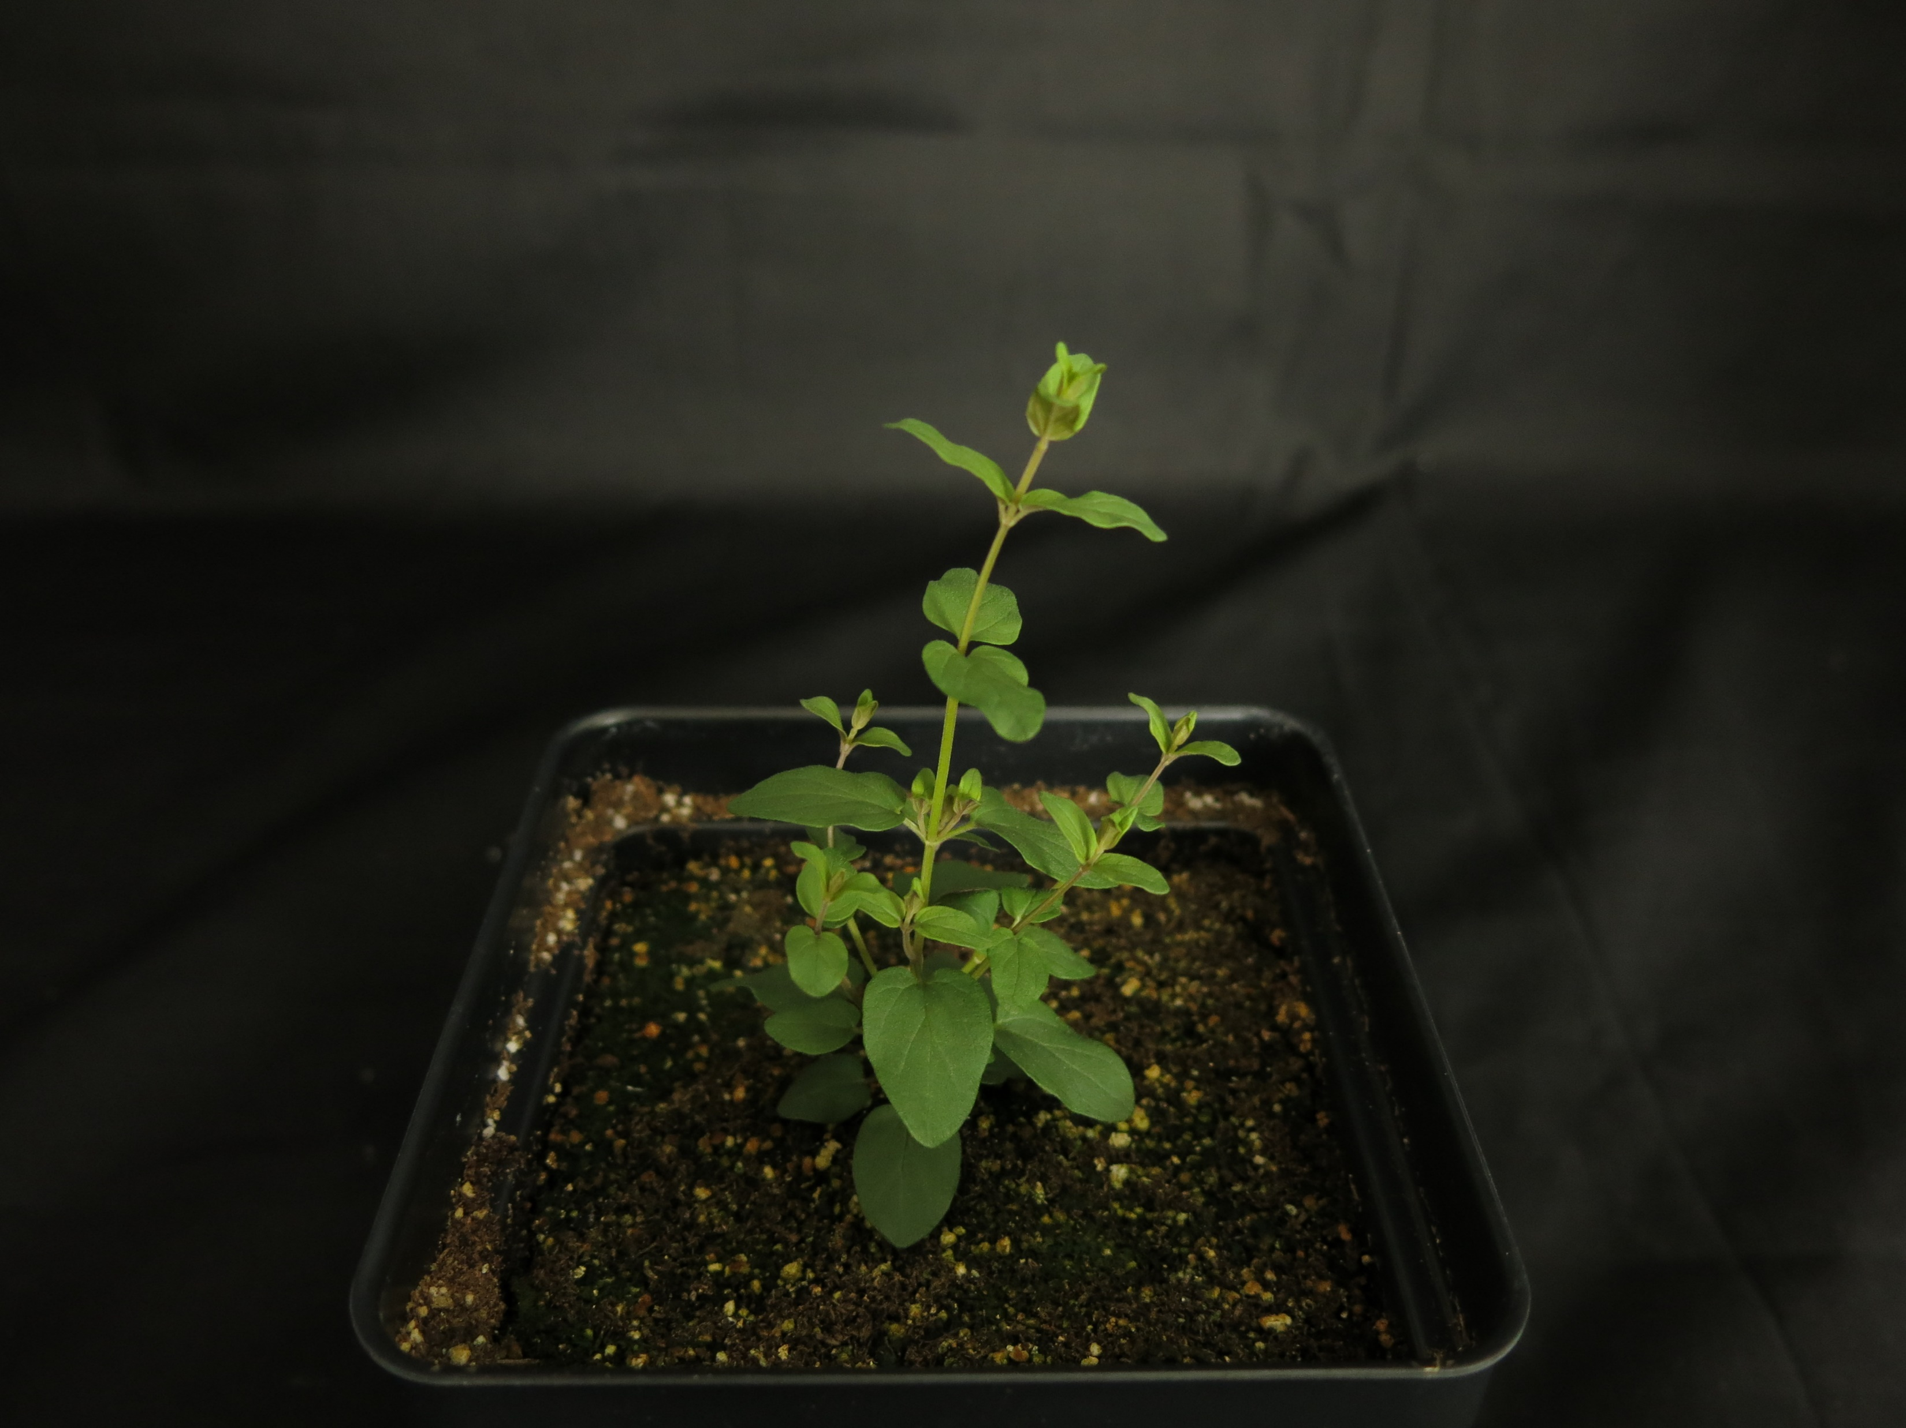
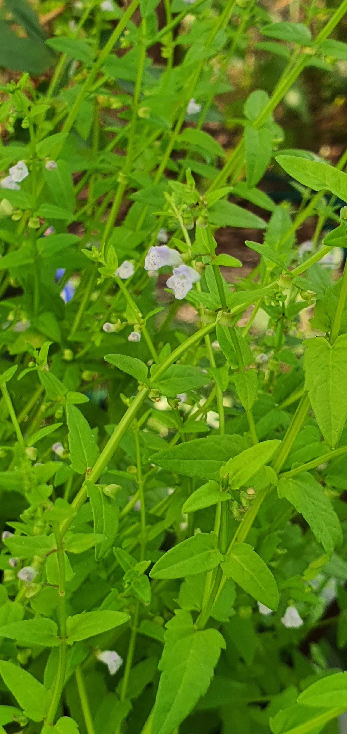
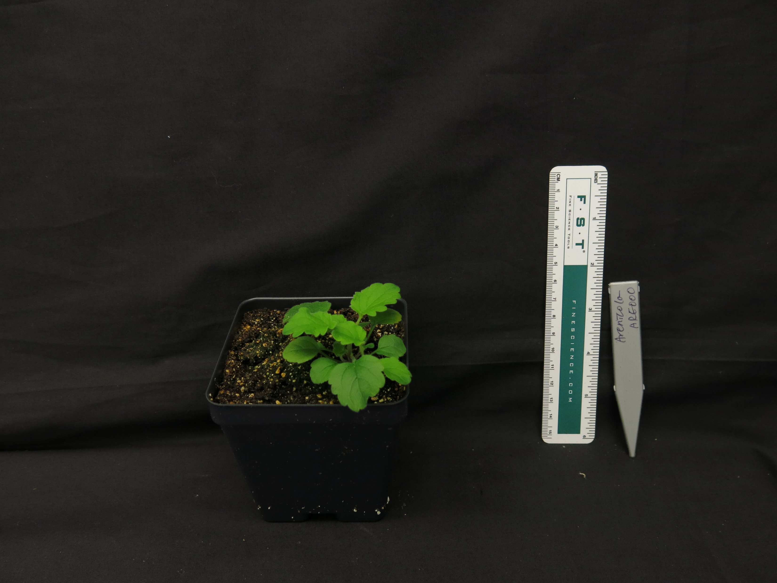
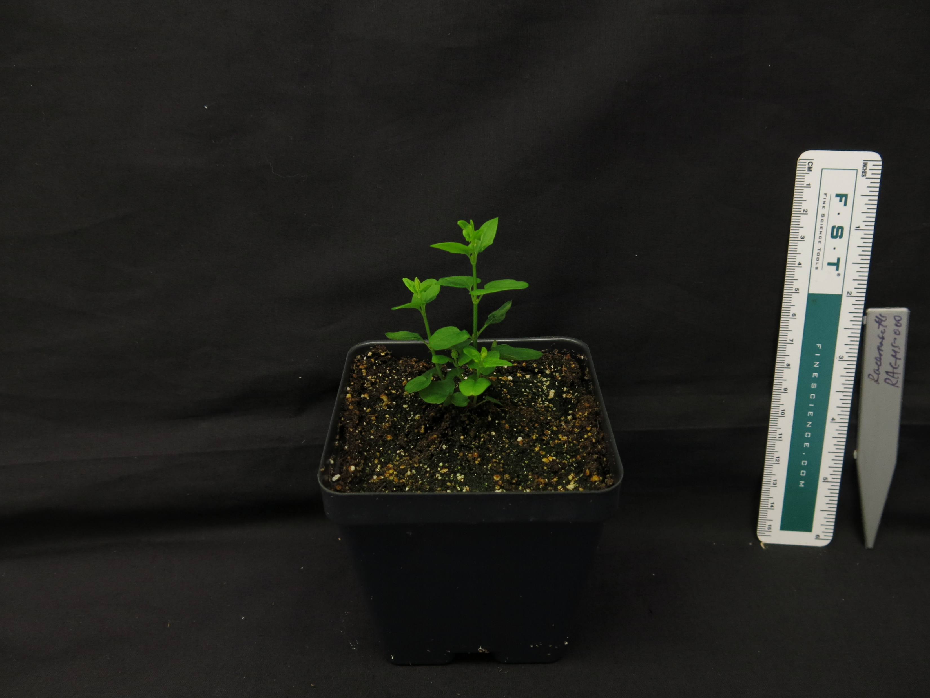
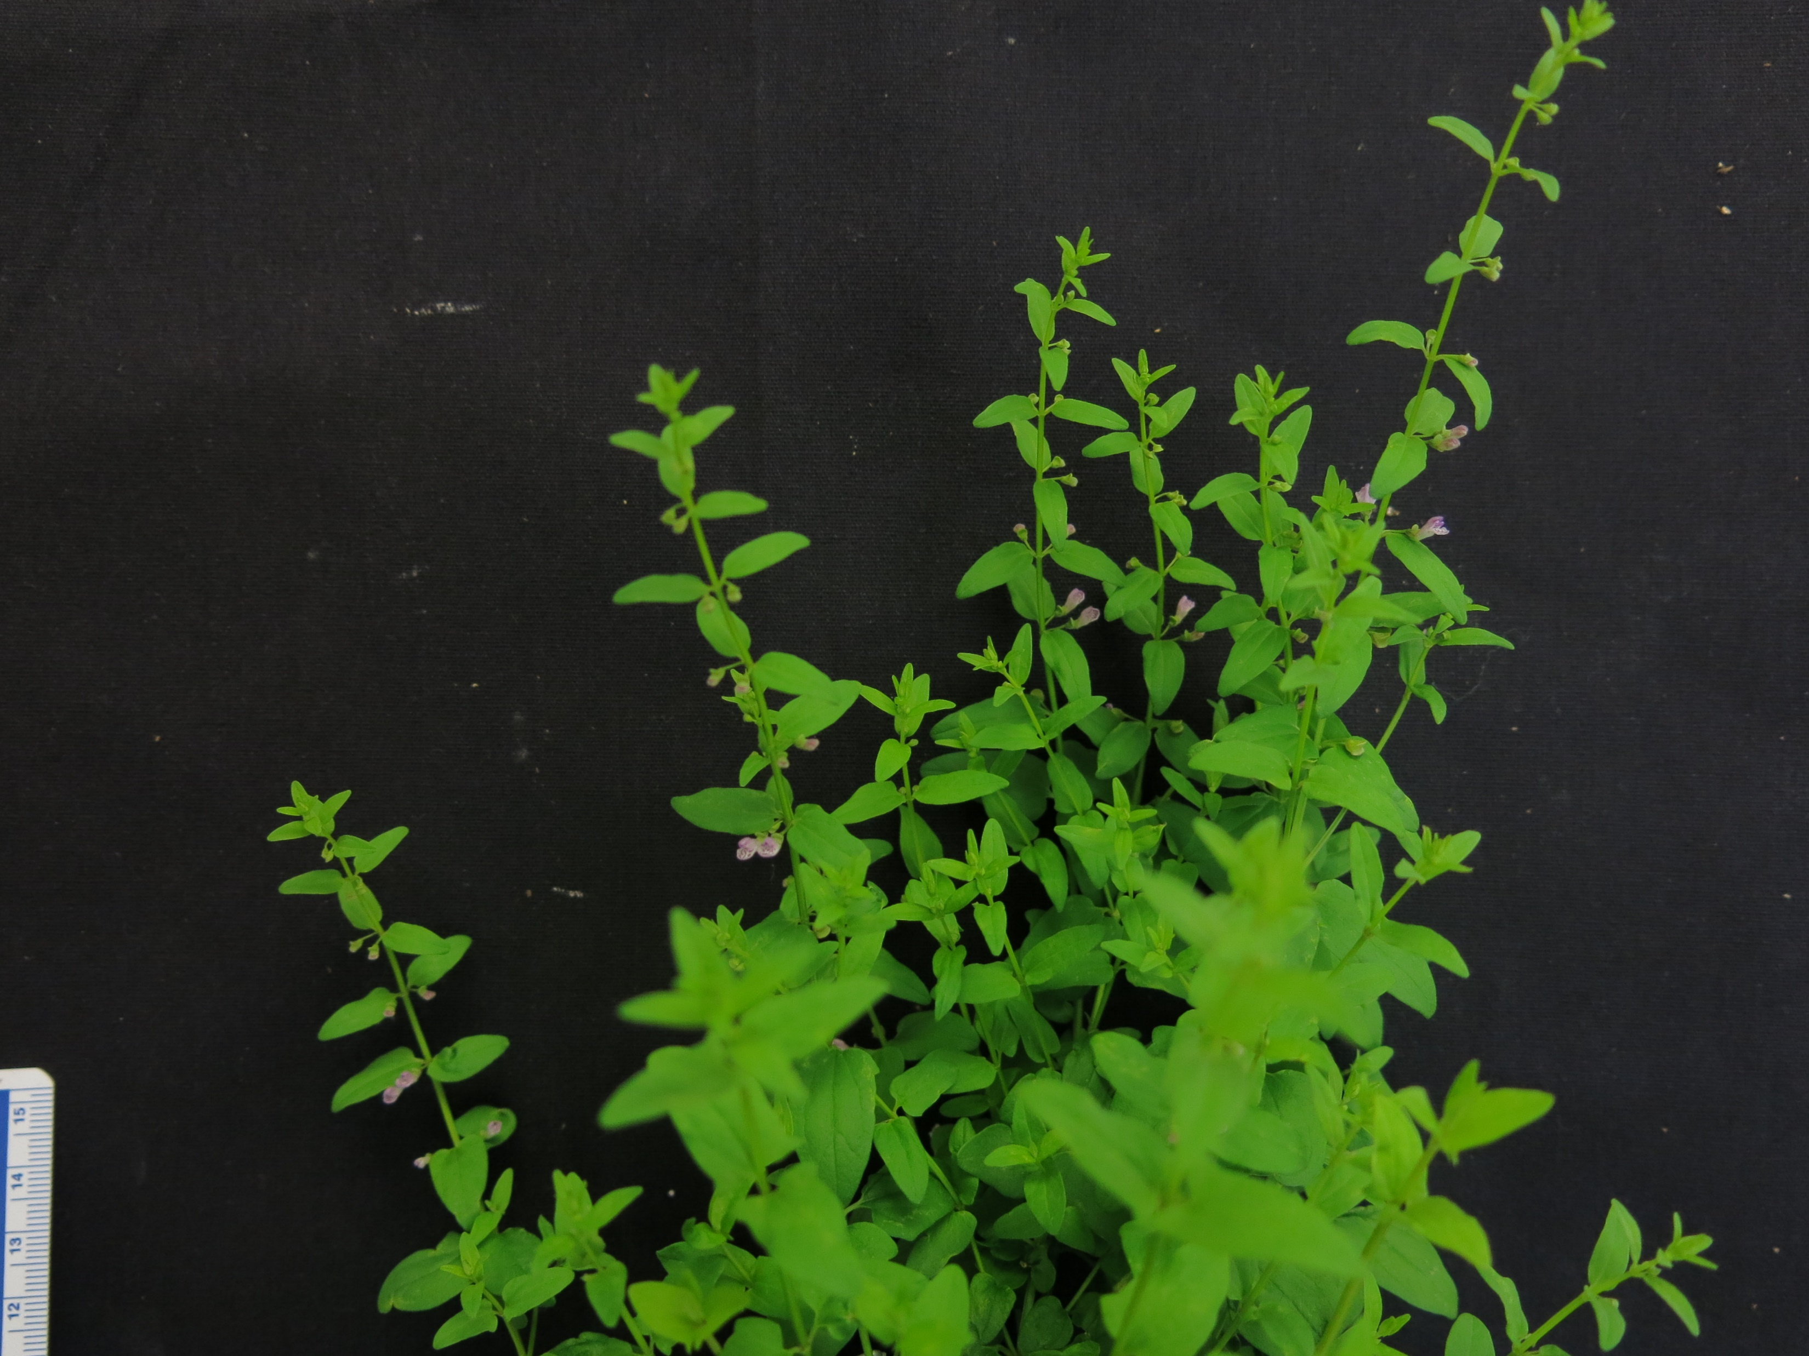
S. baicalensis
S. strigillosa
S. insignis
S. altissima
S. tournefortii
S. indica var. coccinea
S. pekinensis var. alpina
S. barbata
S. havanensis
S. leonardii
S. dependens
S. arenicola
S. racemosa
Scale bar represents 5 cm

Slide 11
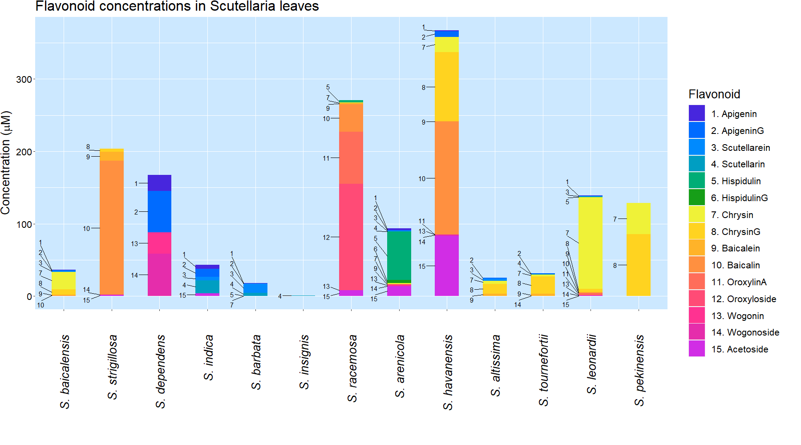

Slide 12
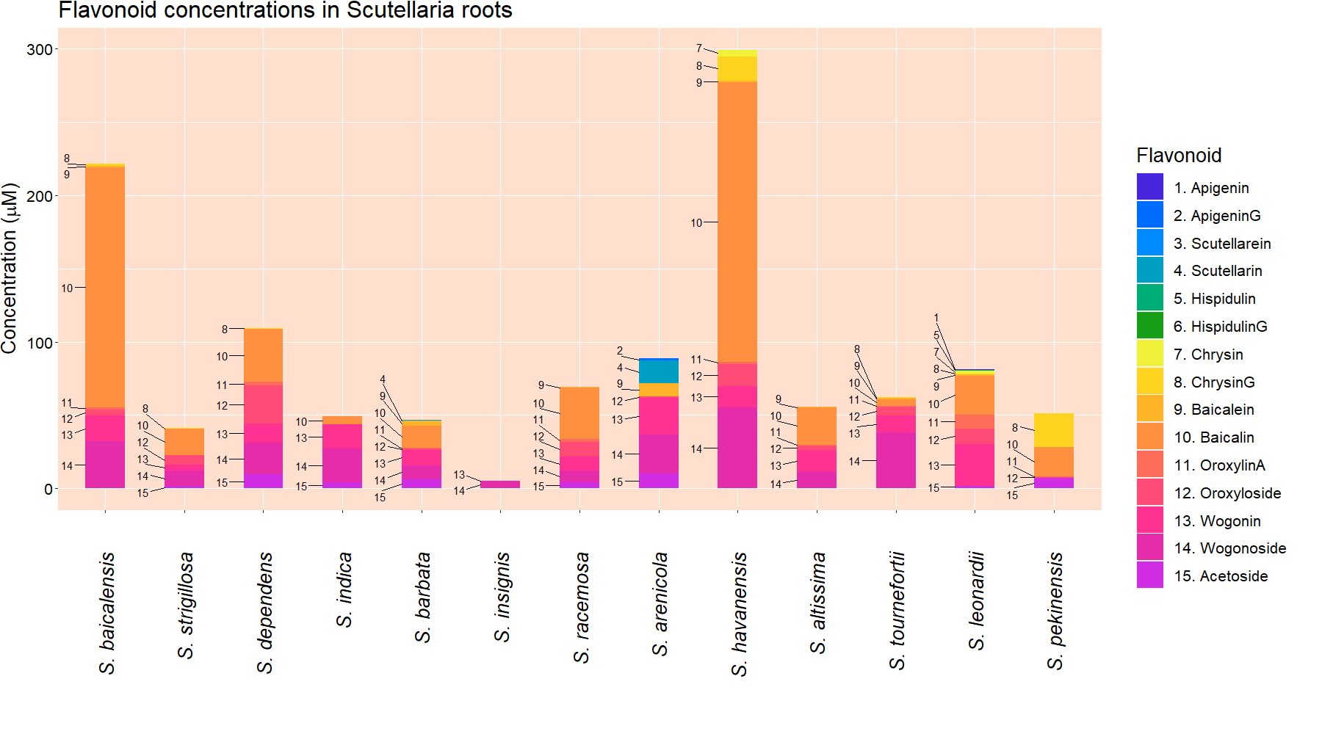

Slide 13













Biosynthetic pathway adapted from Zhao et al. (2016)
2) ApigeninG
4) Scutellarin
4-coumaroyl-CoA
1) Apigenin
3) Scutellarein
5) Hispidulin
6) HispidulinG
Phenylalanine
Cinnamic acid
8) ChrysinG
10) Baicalin
Cinnamoyl-CoA
7) Chrysin
9) Baicalein
11) OroxylinA
12) Oroxyloside
Norwogonin
13) Wogonin
14) Wogonoside
# of species where flavonoid was detected in shoots
# of species where flavonoid was detected in roots

Slide 14
Approach
Better understanding of flavonoid diversity in Scutellaria
Phylogenetic analysis
1) Sequence chloroplast DNA
2) Construct tree and separate into clades
Chemical analysis
1) Non-organ specific flavonoid profiling
2) Organ specific flavonoid profiling
Genome size analysis
1) Flow cytometry
2) Collect chromosome #s from literature

Slide 15
Genome size data
Species | Estimated genome size (Gbp) |  | Chromosome number
 | Measured in this study | Published previously | Published previously
S. baicalensis | 0.54 | 0.38 (Xu et al., 2020) | 2n = 18 (Xu et al., 2020)
 |  | 0.41 (Zhao et al., 2019) | 2n = 18 (Zhao et al., 2019)
 |  | 0.41 (Cole et al., 2008)
S. strigillosa | n.d. | 0.38 (Lee & Kim, 2017)
S. dependens | 0.44
S. indica var. coccinea | n.d. | 0.38 (Lee & Kim, 2017)
S. barbata | 0.52 | 0.35 (Xu et al., 2020) | 2n = 26 (Xu et al., 2020)
S. insignis | n.d. | 0.46 (Lee & Kim, 2017)
S. racemosa | 0.44 | 0.37 (Cole et al., 2008) | 2n = 18 (Cole et al., 2008)
S. arenicola | 0.85
S. havanensis | 0.37
S. altissima | 0.39
S. tournefortii | 0.39
S. leonardii | 0.50
S. pekenensis var. alpine | 0.38 | 0.45 (Lee & Kim, 2017)

Slide 16
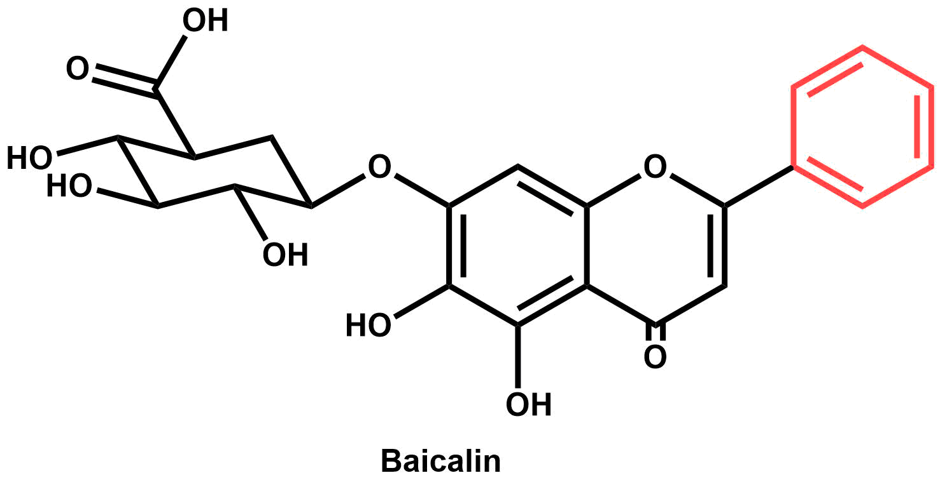
Discussion & conclusion
O
Diversity in flavonoid accumulation indicates differences in biosynthetic pathway
Several biotechnology targets identified
S. havanensis – Baicalin in roots and shoots
S. arenicola – Hispidulin in shoots
S. racemosa – Oroxylin A in shoots
Little correlation between phylogenetic data and flavonoid profiles
Future work – transcriptomic and genomic analysis
Baicalin
S. havanensis
Hispidulin
S. arenicola
H
Oroxylin A
S. racemosa

Slide 17

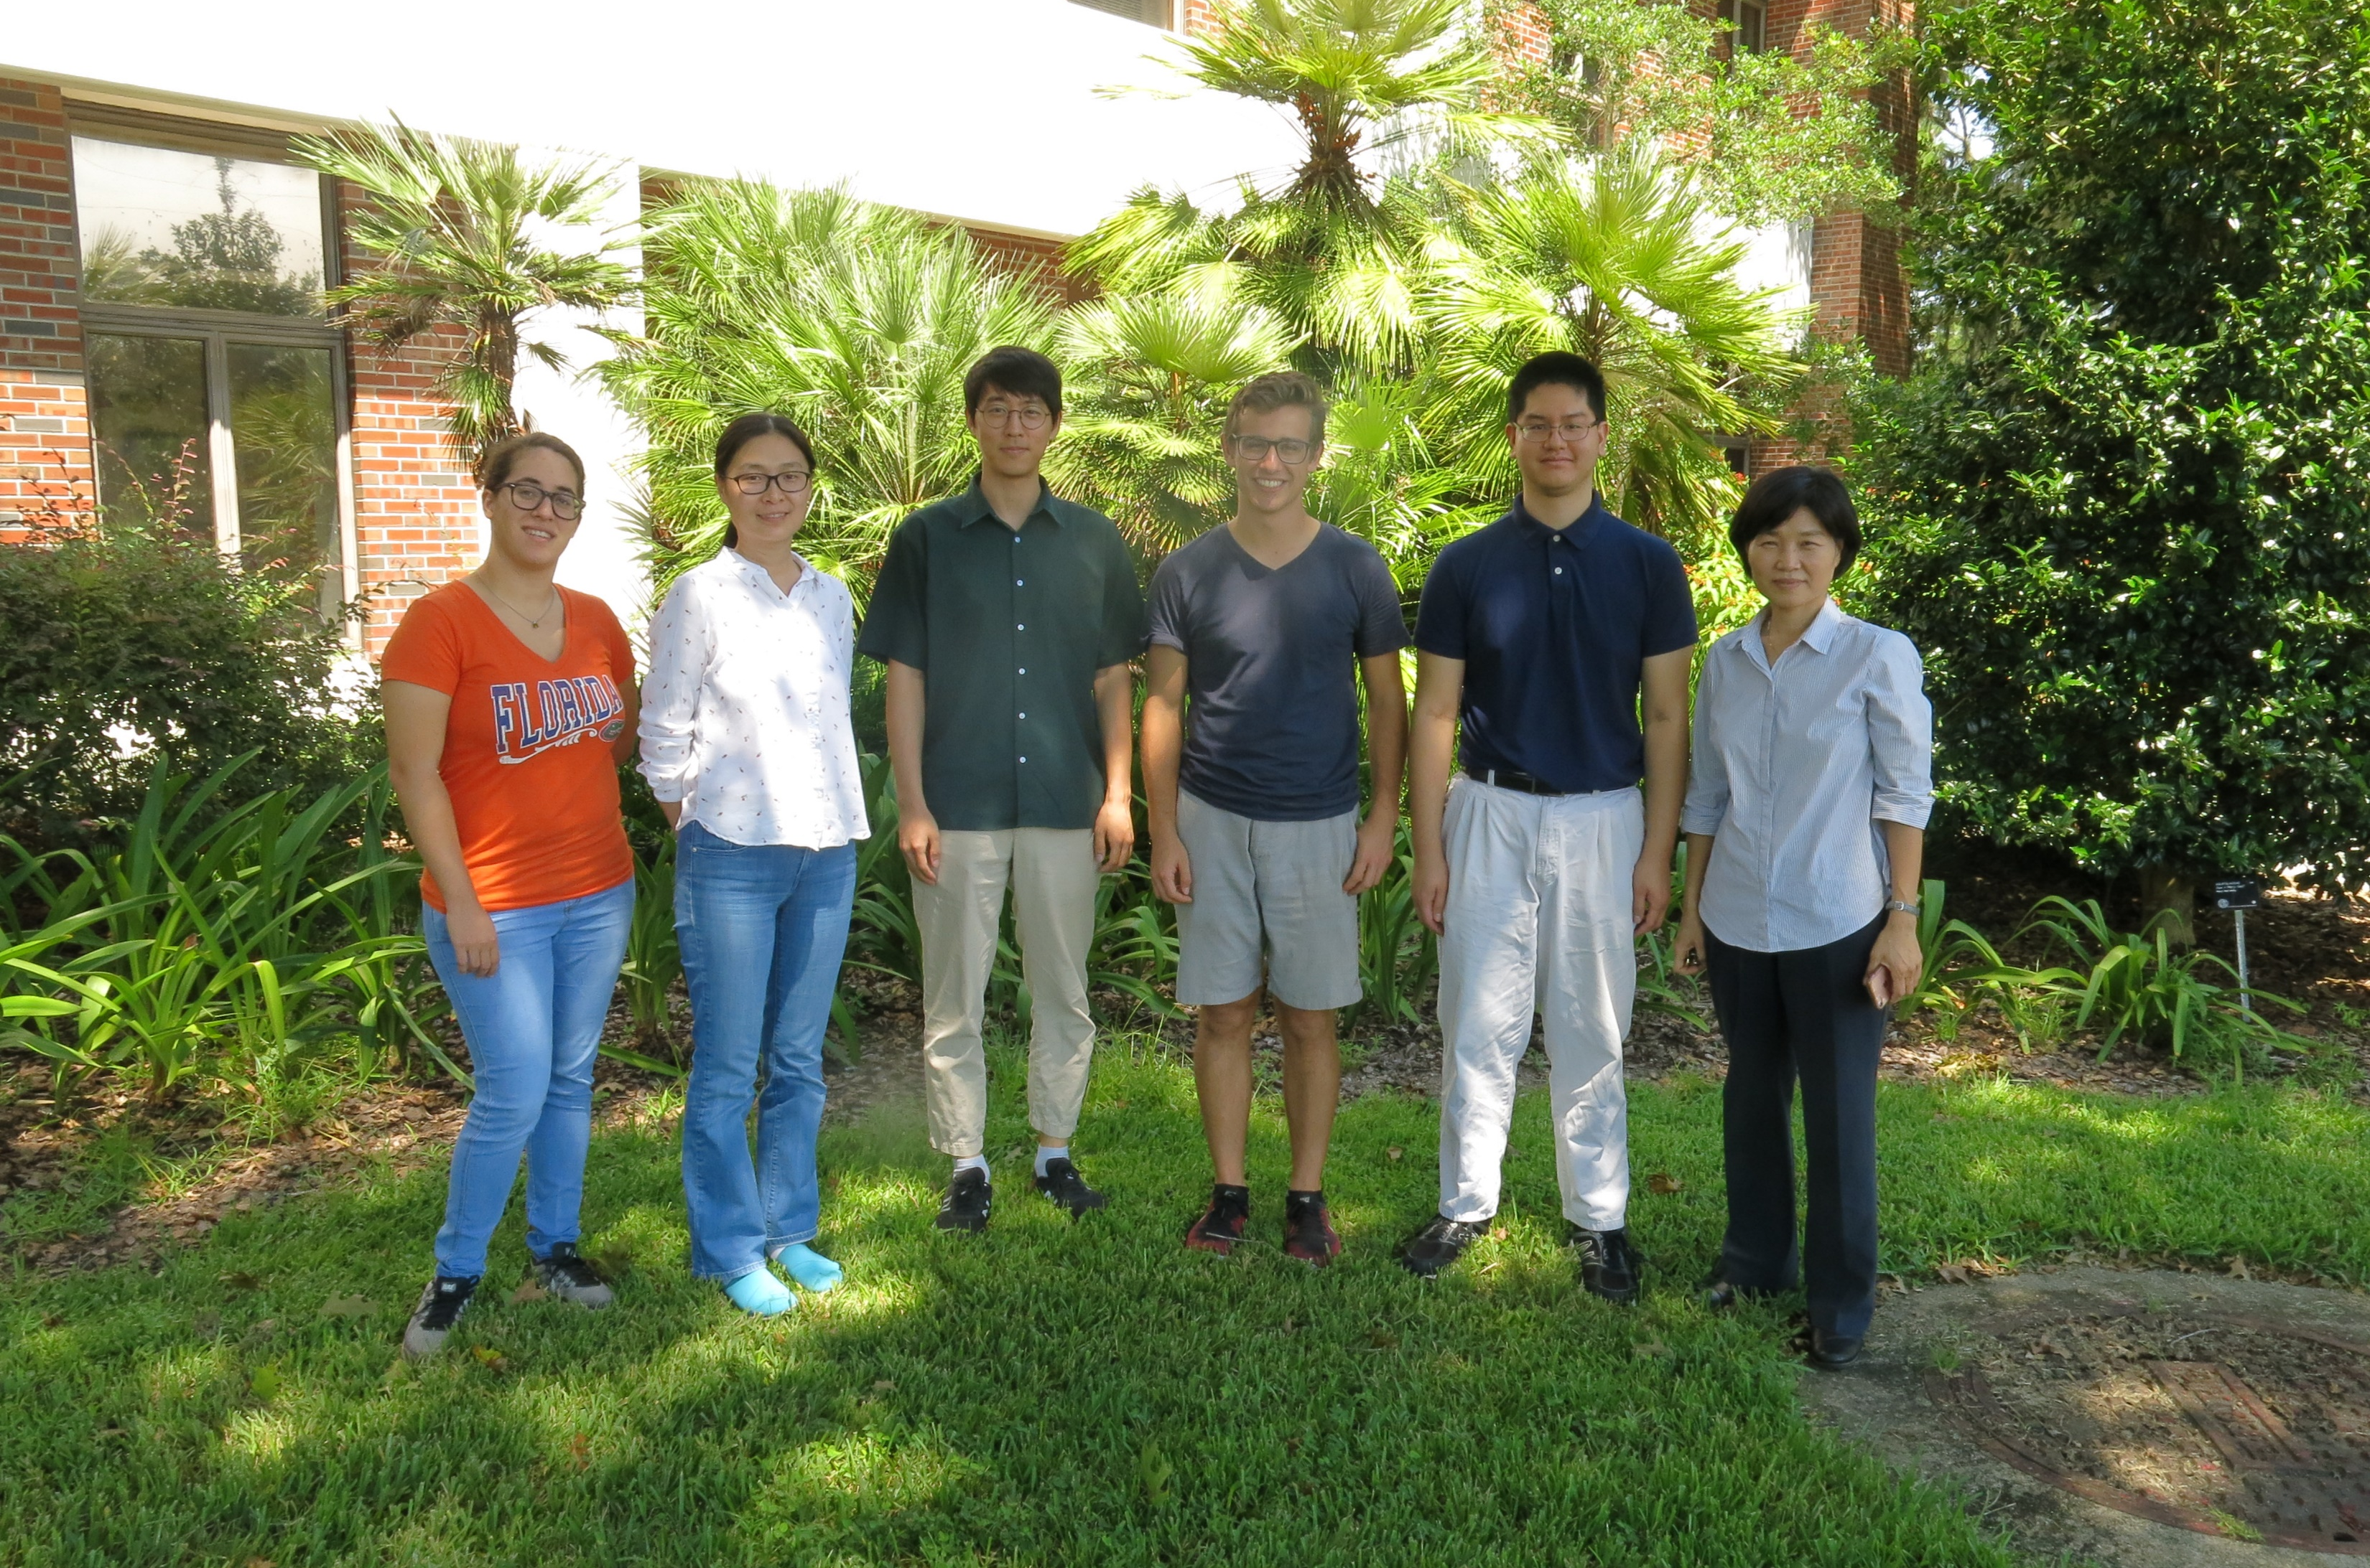
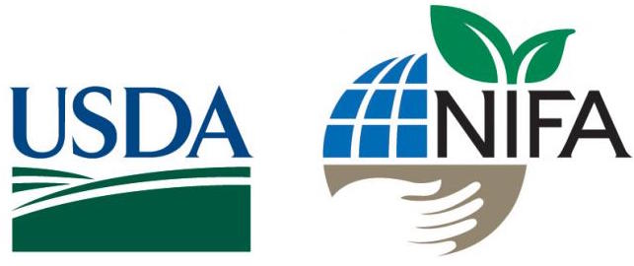
Acknowledgements
Yeong Hun Song¹ - preliminary chemical analyses and developed HPLC method
Yoonkyung Lee² and Sangtae Kim² – phylogenetic and genome size analyses
Ru Dai¹ and Jeongim Kim^{1,3} - sample preparation and keeping my plants alive
Brian Pearson⁴ and John B. Nelson⁵ - provided seed and plant materials used in this study
¹Horticultural Sciences Department, University of Florida, Gainesville, FL, USA
²Department of Biology, Sungshin Women’s University, Seoul, Republic of Korea
³Plant Molecular and Cellular Biology Graduate Program, University of Florida, Gainesville, FL, USA
⁴Environmental Horticulture Department, University of Florida, Gainesville, FL, USA
⁵University of South Carolina Herbarium, University of South Carolina, Columbia, SC, USA
Kim lab
Funding for this project provided by: USDA NIFA-HATCH (Project #005681) and the National Research Foundation of Korea (NRF-2017R1D1A1B03034952)

